Slide 1


Correct in green pen.
Do Now: Recap
Be prepared to feedback your responses to the 5 focus questions from Foner.

Slide 2
How accurate is it to say that minority rights campaigns achieved considerable success in the years 1960–80? [20]
It’s a question, so it needs a ?
underlined
LOs:
1. To identify the gains and limitations of minority rights campaigns 1960-80
2. To weigh up the extent to which success was achieved
3. To compare and contrast the areas of success for each group to identify patterns

Slide 3

Black Civil Rights experiences
Hispanic, Native American experiences
What are the similarities and differences we identified in the 1960s?

Slide 4
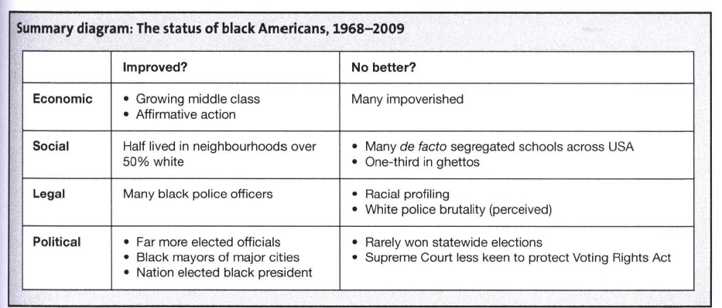

Slide 5



Political and legal status
social status
economic status

Slide 6
Native American Campaigns
Litigation e.g. Montana Northern Cheyenne reservation renegotiation of mineral rights, Washington ‘fish-in’.
Red Power – when AIM monitored police, NA in jail by 60%; 1967 ‘reoccupation’ of Alcatraz island; 1973 Wounded Knee Pine Ridge occupation
‘Indian Bill of Rights’ within 1968 CRA
Johnson’s War on Poverty may have encouraged dependency
Still amongst poorest Americans

Slide 7
How far do you agree that Native Americans had made significant gains in their fight for civil rights by 1980? [20]
Gains | Limitations
Task:
Use the A4 handout to list examples of success / lack of success.

Slide 8
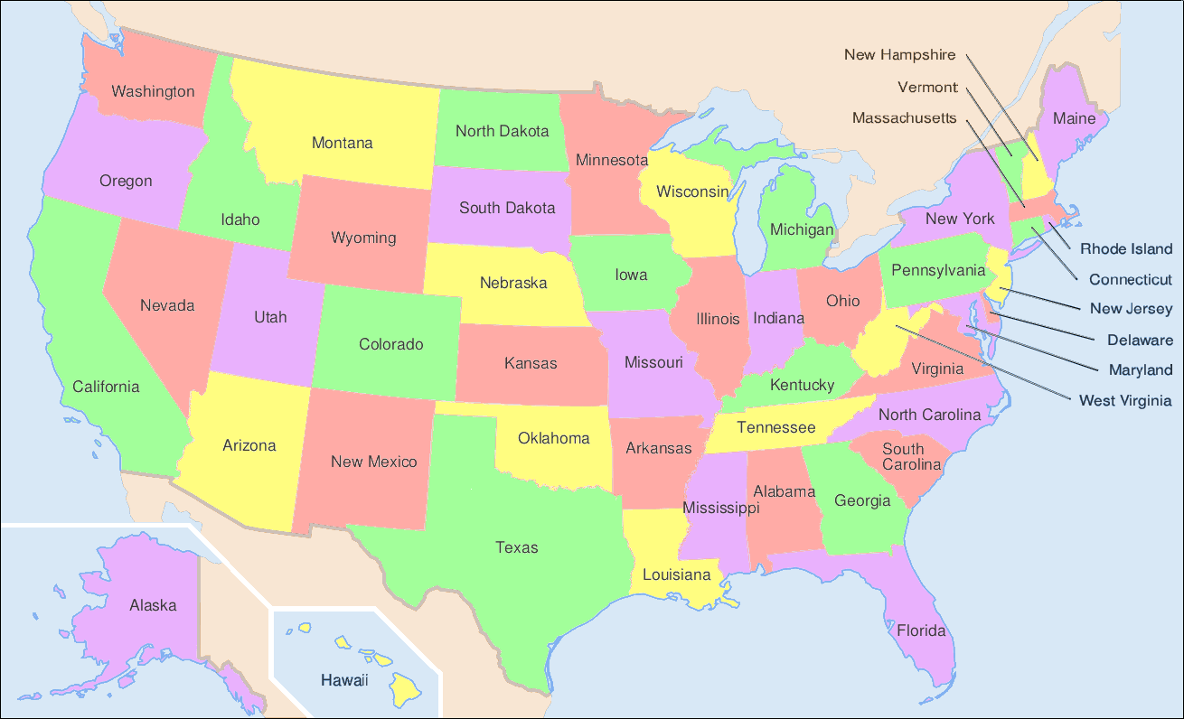
Hispanic = Spanish speaking background
Puerto Ricans = Poor areas of Northern cities, especially Chicago and NYC.
Mexicans = Texas and California, often working on the land. The bracero programme of 1942-64 guaranteed incoming the same wages as existing workers, guaranteed levels of housing and working conditions and work for a period of time. 4.6m contracts signed.
This did not always work, and the fact that Mexican immigrants accepted lower wages encouraged resentment amongst existing labourers.
Cubans = Florida

Slide 9
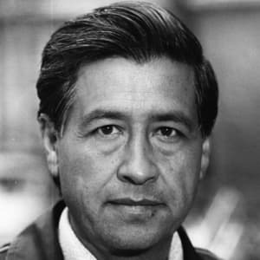
Cesar Chavez
The black civil rights movement inspired other ethnic minorities to push for better civil rights.
Chavez was an American of Mexican ancestry and like many had been a migrant farm worker.
He created the United Farm Workers union in 1965 and helped organise a strike against grape growers in California.
Like MLK he supported non-violent methods and led supporters on a 300mi march to the state capitol to protest for more civil rights.
Part of the problem was that Mexican-Americans were less educated than blacks, many did not speak English and were illegal immigrants.
His actions led to better rights and a greater pride in Mexican-American culture and Catholicism.

Slide 10
How far do you agree that Hispanics had made significant gains in their fight for civil rights by 1980? [20]
Gains | Limitations
Task:
This time, use the Sanders handout.
Challenge:
Add further similarities and differences to your Venn diagram

Slide 11
Black Civil Rights experiences
Hispanic and Native American experiences

Slide 12

“Black Civil Rights campaigns achieved considerable success in the years 1960–80”. How far do you agree with this statement?
Agree
Strongly Agree
You cannot sit on the fence!
Disagree
Strongly Disagree

Slide 13
Task:
This time, use the summary hand out to ADD to your existing notes in a different colour.
Why is this useful?
Challenge:
Colour code / code with letters similarities and differences in:
Economic status
Political status and recognition
Legal gains / discrimination
Social gains / problems

Slide 14
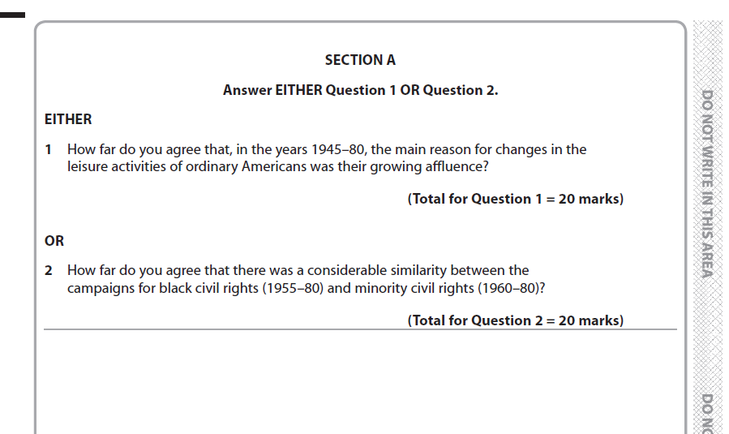
June 2018

Slide 15
Sample material
How accurate is it to say that minority rights campaigns achieved considerable success in the years 1960–80? [20]
Use the mark scheme to plan your answer.
Homework: Create a detailed plan for this question.
Foner reading. Be prepared to answer the 5 focus questions.

