Slide 1
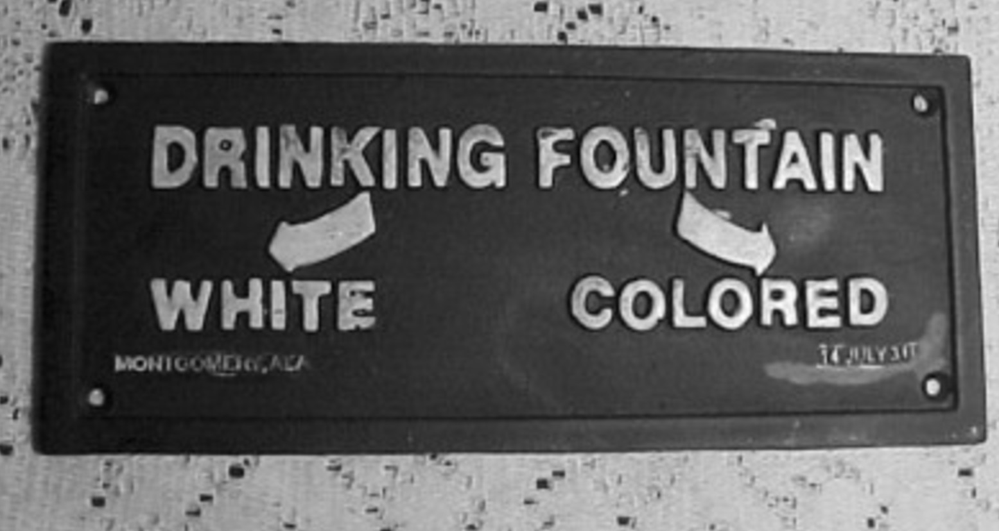
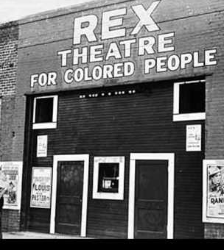
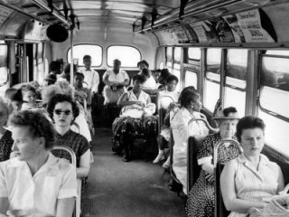
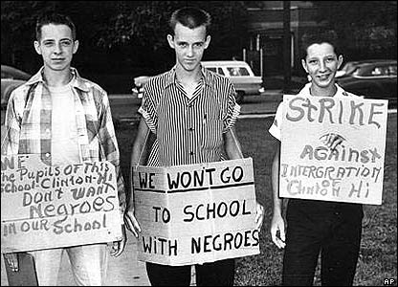
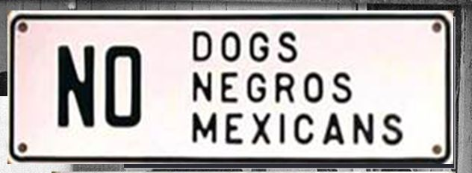
Notes:
Emmett Till: https://www.history.com/this-day-in-history/the-death-of-emmett-till
Selma trailer: https://www.youtube.com/watch?v=BWKaq80cKSA
Kid President: https://www.youtube.com/watch?v=4xXZhXTFWnE
I have a dream speech: https://www.youtube.com/watch?v=3vDWWy4CMhE

Slide 2
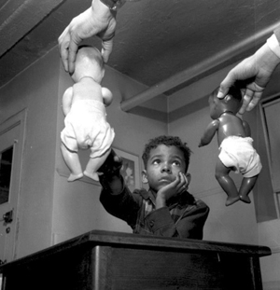
The doll test
In the 1940s, psychologists Kenneth and Mamie Clark designed and conducted a series of experiments known colloquially as “the doll tests” to study the psychological effects of segregation on African-American children.
Drs. Clark used four dolls, identical except for colour, to test children’s racial perceptions. Their subjects, children between the ages of three to seven, were asked to identify both the race of the dolls and which colour doll they prefer. A majority of the children preferred the white doll and assigned positive characteristics to it.
The Clarks concluded that “prejudice, discrimination, and segregation” created a feeling of inferiority among African-American children and damaged their self-esteem.
This test was used as evidence in the Brown v Topeka Board of Education hearing
https://www.youtube.com/watch?v=WG7U1QsUd1g

Slide 3
How successful were Supreme Court rulings and federal government action in challenging segregation 1945-61?
LOs:
1. To explain how attitudes towards segregation had changed since World War Two
2. To weigh up the successes and limitations of both Supreme Court rulings and federal government action in challenging segregation in education and public transport
3. To reach a judgement on how far you agree with the backlash thesis

Slide 4
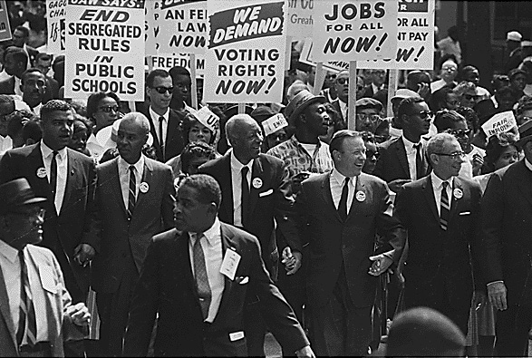
Civil Rights Movement: Dictionary definition
The people in the 1950’s-1970’s in the USA who campaigned for equality for Black Americans – mostly by aiming to end segregation.

Slide 5
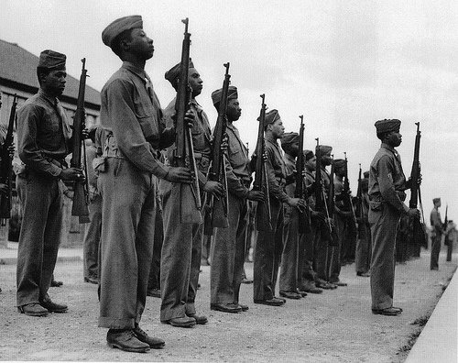

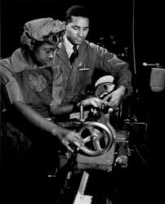
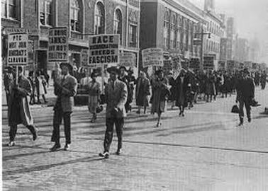
World War Two: 1941-45 (for the USA)
Surely if we fight in this war and help in the factories (for MUCH lower wages……..

Slide 6
1948 – President Truman introduced a Civil Rights plan which included an anti-lynching bill and a ban on measures to stop poor people from voting.
However, Truman faced opposition from his own party and his plans had to be dropped.
The armed forced were desegregated
The government was told to employ a higher percentage of African Americans.

Slide 7
Task one:
Using pages 107-108 of Paterson and Willoughby, explain how and why black and white attitudes changed towards segregation after 1945.
Summarise each in no more than a sentence or two or simply make a list of key reasons.
Challenge:
Truman was not a champion of black civil rights and yet he proved to be the most helpful president since Lincoln. Why might Truman want to appear to improve civil rights for black Americans?

Slide 8
Task two:
As we read through each development, you need to summarise what the success or limitation was in two/three words – there is a blank line for you to do this next to each heading.
Useful words to explain impact/limitations:
Precedent
Enforcement
Attitudes
Federal intervention
State reluctance

Slide 9
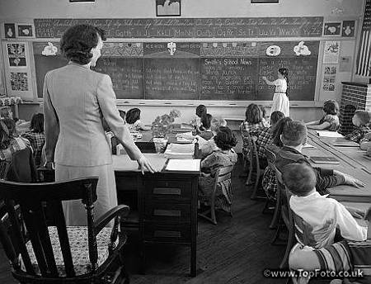
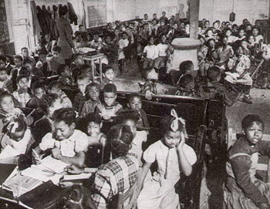
What is the difference?
WHITE SCHOOLS
BLACK SCHOOLS
Carolina state spent $179 per year educating white children.
Carolina state spent $43 per year educating black children.

Slide 10
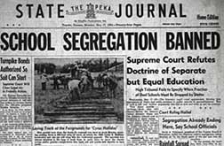
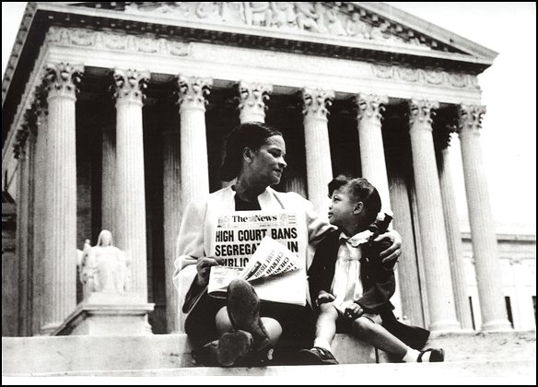
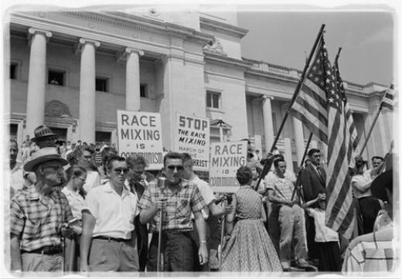
Brown Vs Topeka 1954

Slide 11
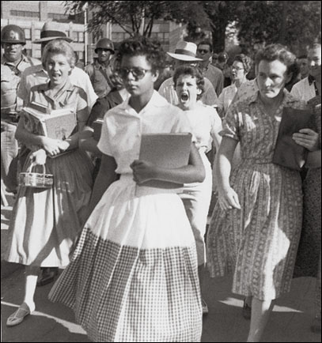
Little Rock Nine, 1957
Elizabeth Eckford, one of the 9 Students in Arkansas attending a school that was previously just for white students

Slide 12
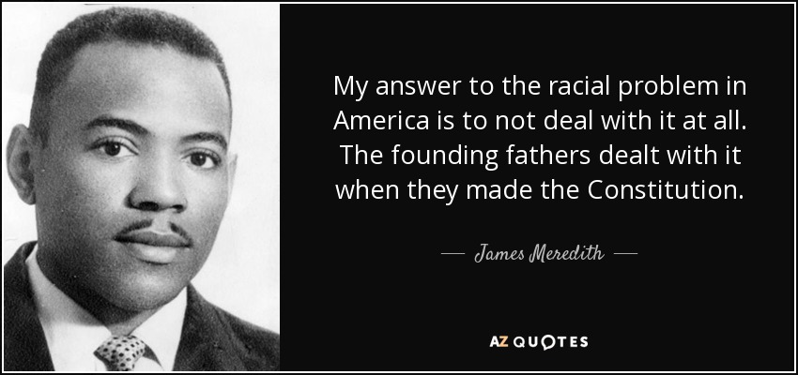
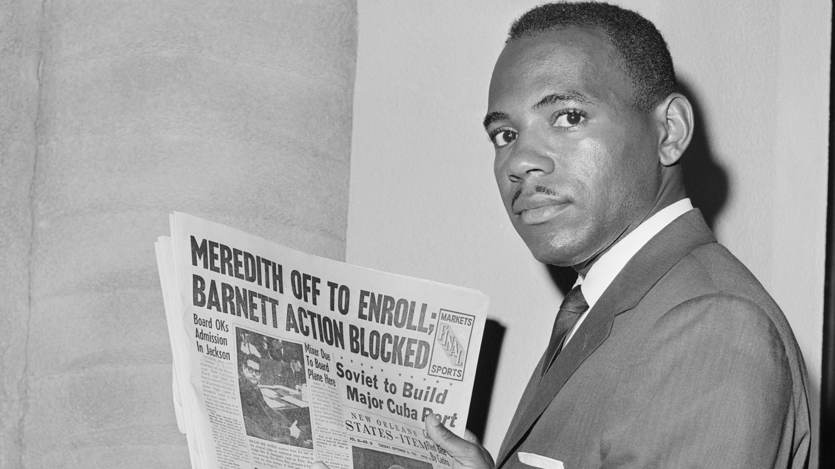

Slide 13
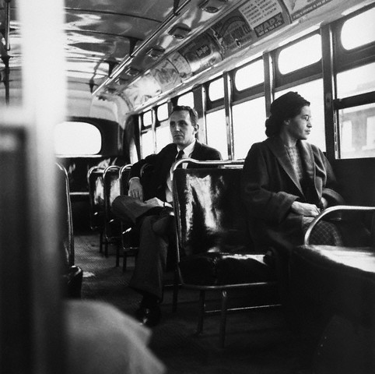
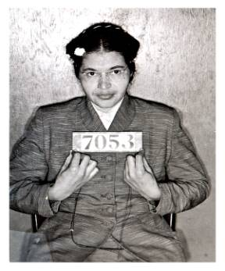
Rosa Parks and bus boycotts, 1955
https://www.youtube.com/watch?v=VMACKNh5MuY
Why Rosa?

Slide 14
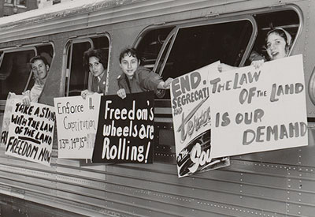
The Freedom Rides, 1961
People riding on public transport with signs arguing that black and white people should be able to sit together on buses

Slide 15
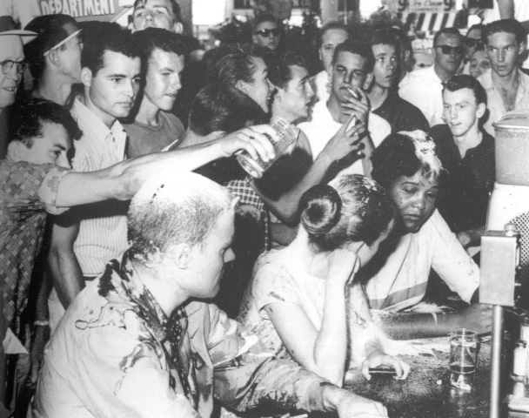
Lunch counter sit-ins, 1960
People sitting at a lunch bar that was meant to be for white people only.

Slide 16
Task three: Knowledge check
You have been given key individuals / events / problems on your cards.
Use the arrows to create a whole-class mind-map of early challenges to segregation during the 1950s and early 1960s.
Challenge: Would blank cards help? Ask me for some!
How can we group these example cards?
What categories can you think of?
What were the key reasons why challenges were / were not successful?

Slide 17
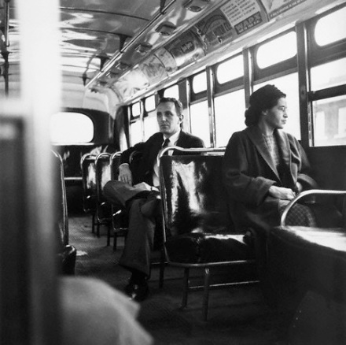
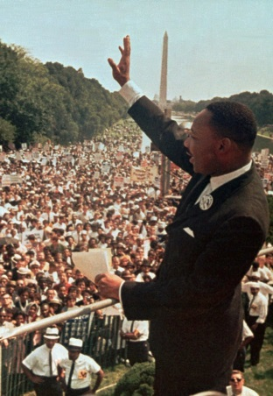

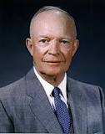

Which factor (reason) was MOST important in helping to achieve civil rights? Which factors hinders progress most?
Legal action (Supreme Court rulings & NAACP cases)
The role of individuals
Non-violent Direct action
Federal
intervention

Slide 18
Task four: Read the first 2 pages of Klarman’s ‘Backlash Thesis’
What does Klarman argue?
Did we need to read the entire article to find that out?
What examples does he use to support his claim?
Challenge:
Why are article useful to us in our reading? What might they serve as models for?

Slide 19
Task five: Use the A3 handout to complete your A3 table. Give details, successes and limitations of challenge to segregation. You also need to give a success rating (5 = highest) and justify your decision. The handout includes events in both breadth (p.94-99) and depth (p108-121), so you can choose to read about some events in greater depth (e.g. Brown v Topeka).
Homework reading:
What was the impact, both short and long term, of the Supreme Court decisions, mass protests and federal government intervention during the 1950s on segregation, civil rights and the relationship between black and white Americans?

Slide 20
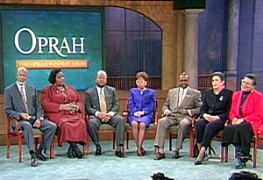
What happened when White and Black students from Little Rock met again on the Oprah Winfrey show……?
https://www.youtube.com/watch?v=SAsh_PDr1cc

