Slide 1


Correct in green pen.
Do Now: Key terms
Match the key terms about social policies to their descriptions.
Some you should know from previous work and some may be from general knowledge – use a process of elimination for any you are unsure of.
Challenge: Overall, how successful were Reagan’s economic policies in achieving their aims?

Slide 2
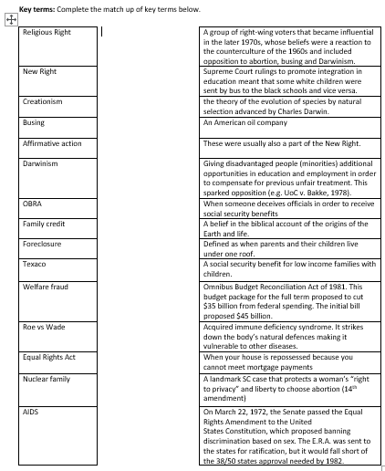

Slide 3
5.1 What was the nature and extent of social change under Reagan?
LOs:
1. To recall Reagan’s conservative social values and the influence of the Religious Right in the 1980s.
2. To explain how Reagan’s policies exacerbated social inequality
3. To evaluate the extend to which Reagan’s policies limited the advancement of women and minority groups.

Slide 4
Tuesday 18th June 8.50am - Paper 1
A full paper – 3 sections
2 hours 15m
Aim to spend 45m on each section
Aim to spend 5 minutes annotating extracts in Section C, then 40m writing.
For section C, you will only be tested on the topics covered up until last week – 5.1 and 5.2
For revision: course guide
Knowledge checklists
Practice Qs

Slide 5
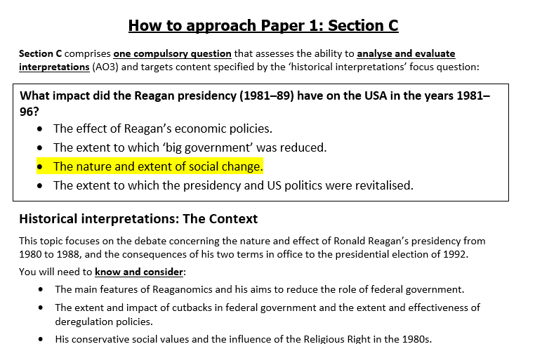

Slide 6
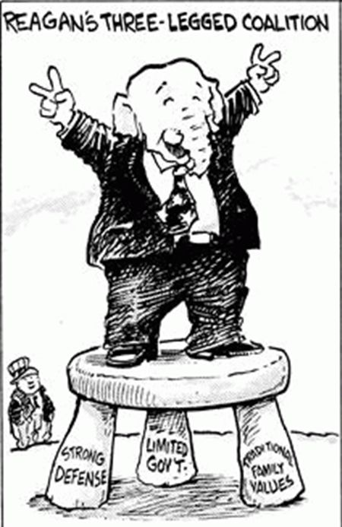
What were Regan’s main aims in 1980?

Slide 7
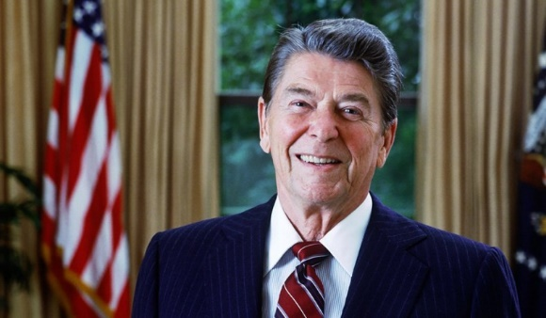
Ronald Reagan’s family values
https://www.youtube.com/watch?v=pDIueebd12M
Task One: Family Values
1. After the clip, you will need to summarise Reagan’s beliefs about family values.
Rules:
- You can make notes during the clip (e.g. key words)
-Your summary of his family values cannot be more than 2 sentences long.

Slide 8
Ronald Reagan’s family values
https://www.youtube.com/watch?v=pDIueebd12M
Task One: Family Values
Reagan believes that the Christian nuclear family is central to the American Dream, the American model of civilisation, but has “come under attack” in recent decades (i.e. liberalism).

Slide 9

Task One: Family Values
2. Now use pages 211 and 212 of Sanders to make a list of Reagan’s core social values (up to ‘the war on drugs’) under your summary.
3. Spot the ironies – how did aspects of his life differ from the values he proposed?
Challenge:
Why did Reagan fail to pass much of his social legislation? Why could / would he not endorse legislation?

Slide 10
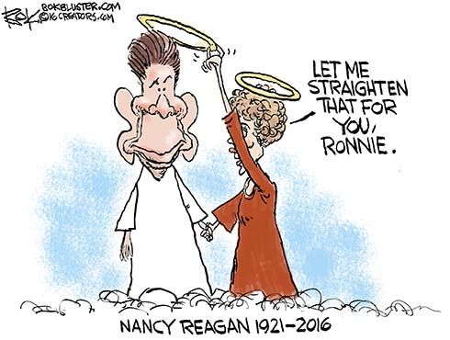
Ronald Reagan’s family values?
The first president to be divorced and remarried
Piper Laurie claimed she’d lost her virginity to a much older Reagan
Nancy’s prescription medication addiction

Slide 11
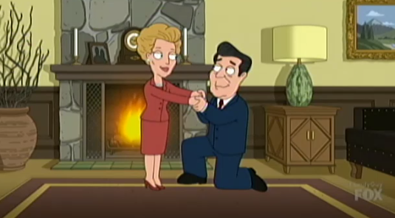
What is the popular perception of Reagan’s social policies?
https://www.newsbusters.org/blogs/culture/lindsay-kornick/2018/01/07/family-guy-nancy-reagan-turned-blind-eye-aids-crisis

Slide 12
Do you think that this popular perception is entirely accurate?
AIDS research more than doubled during Reagan’s presidency
Nancy’s Just Say No programme
Targeted drug dealers

Slide 13

How would Reagan secure the passing of his social legislation?

Slide 14
Task Two: How did Reagan secure the passing of his social legislation?
Use pages 213-5 of Sanders to explain:
  /
Which presidential power did Reagan attempt to use to secure the longevity of his social policies?
Why did he nominate Robert Bork?
What changes did he make to the judiciary?
Why was this judicial strategy a success?
Challenge:
Did the judiciary and Reagan always support the Religious Right?

Slide 15
Task Three: What was the nature and extent of social change?
Use pages the handouts (mainly Pearson p.128 onwards) to complete your allocated row.
We will then share to complete.
Challenge:
How far did Reagan widen the gap between rich and poor? Explain your answer.

Slide 16
In the light of differing interpretations, how convincing do you find the view that the Reagan presidency was a time of ‘deterioration and decline’ (Extract 1, lines 7–8) in the advancement of black Americans in the USA?
To explain your answer, analyse and evaluate the material in both extracts, using your own knowledge of the issues. (20 marks)
Task: Section C practice
Read the two extracts.
Identify the overall view of each extract
Highlight at least two quotes to support your inferences

Slide 17
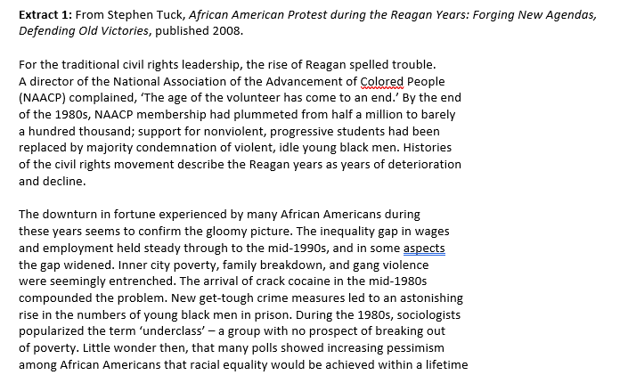

Slide 18
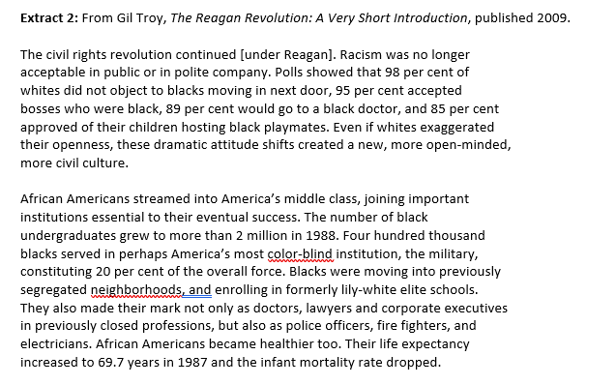

Slide 19
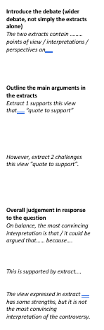
Task
Attempt your introduction using the structure strip – stick this down the left hand side of your page.
Challenge:
How would you structure the rest of the essay?

