Slide 1


Do Now: Recap
Give at least one reason why Nixon won the election of 1968.
Give at least one example of Nixon’s ‘pragmatic’ leadership style
Give at least one example to support’s Schlesinger's view that he was an ‘imperial’ president.
Correct in green pen.
Challenge: What was the short and long term impact of Watergate?
Notes:
Anti-Communist; appealed to silent majority; absence of Bobby and Johnson (won popular vote by less than 1%)
Détente; welfare expenditure increased
Presidential image

Slide 2
Do Now: Recap
Give at least one reason why Nixon won the election of 1968.
Give at least one example of Nixon’s ‘pragmatic’ leadership style
Give at least one example to support’s Schlesinger's view that he was an ‘imperial’ president.
Correct in green pen.
Anti-Communist; appealed to silent majority; absence of Bobby and Johnson (won popular vote by less than 1%)
Détente; welfare expenditure increased
Cambodia 1970
Challenge: What was the short and long term impact of Watergate?
Notes:
Anti-Communist; appealed to silent majority; absence of Bobby and Johnson (won popular vote by less than 1%)
Détente; welfare expenditure increased
Presidential image

Slide 3
Homework
Finish outstanding notes on Carter and Ford.
Read the article on ‘reading effectively and efficiently’. What strategies could you use to become both effective and efficient readers? (create a flow chart / spider diagram / list).
Show evidence of a piece of wider reading you have done this week (a textbook, the reading list, the various photocopies we give you etc.), applying at least one strategy suggested in the article.

Slide 4
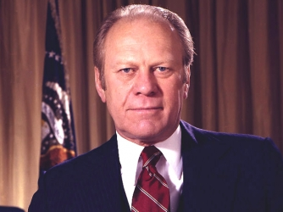
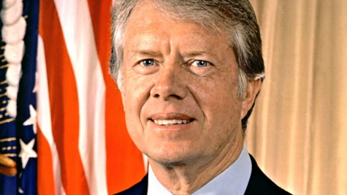
How far did Ford and Carter successfully restore the reputation of the Presidency?
LOs:
1. To assess the extent to which Nixon and Watergate damaged the presidency
2. To describe the personalities and policies of both Ford and Carter
3. To evaluate their successes and failures in attempting to restore confidence in the presidency.

Slide 5
The impact of Watergate
Task one: How did Watergate damage the Presidency?
Page 26
How did Nixon react to Watergate? Read sources 13.9 and 13.10 and explain your answer.
To what extent did Watergate damage the Presidency? Make a list of arguments for and against using diagram 13D.
Challenge:
‘Nixon’s personality has since been overly-scrutinised for evidence of immorality, where other presidents’ have not’. How far do you agree with this statement?

Slide 6
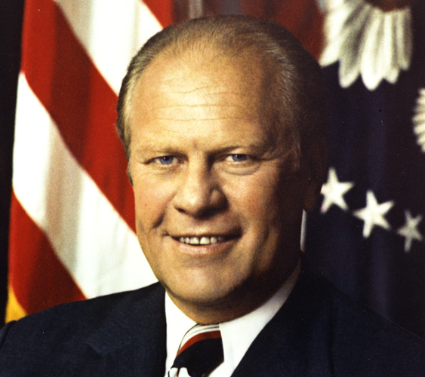
Immediately after Watergate....
Spiro Agnew resigned as Vice President (tax evasion and bribery) in October 1973. Nixon chose popular Congressman Ford as VP.
When Nixon resigned, Gerald Ford took over as President of America. Ford remains the only unelected president in American history.
Ford was a ‘regular guy’, an uninspiring man who was elected as vice president because he was ‘safe’ – i.e. He was not corrupt.
https://www.youtube.com/watch?v=A0-AD3bFjF8

Slide 7
Backfire!
However Ford’s association with the previous Republican leaders and the scandals that surrounded them would not go away.
In September 1974 Ford issued a Presidential pardon to Richard Nixon stopping all investigations into his conduct whilst president.
This just told the American public that all politicians stuck together and ‘looked after their own’. That they would always find a way of ‘getting away with it’!

Slide 8
In October 1974 he attempted to stop a Freedom of Information Act saying it would damage the CIA.
This confirmed to many that Ford was trying to protect his friends in the Republican Party by using Presidential power. Again, the politicians were trying to ‘dodge justice’.
Ford’s veto was overturned by Congress and the Senate.

Slide 9
Elections
Half way through his presidency there were Senatorial elections. The American voters showed what they thought of the scandals following the Republican Party and elected a Democratic Senate.
This Senate vetoed over 50 of Ford’s proposed legislations. It was becoming impossible for Ford to continue.

Slide 10
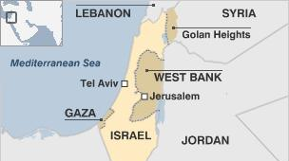
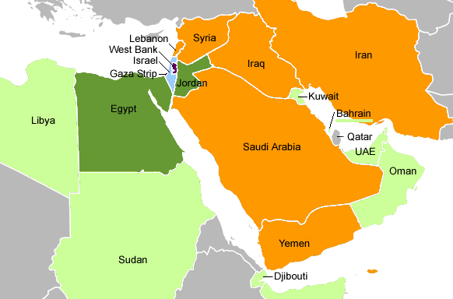
The economy and the Middle East
A very short History!
After 1914, the Ottoman Empire was dismantled and divided amongst the Allies.
In 1945, the UN proposed to partition Palestine between Arabs and Jews because the British were finding it increasingly difficult to manage the area.
In 1947, when the British withdrew from Palestine, Jewish settlers proclaimed the new state of Israel.
When Israel was attacked by its Arab neighbours from 1947, the USA formally recongised the state and offered assistance.
In 1973, the OPEC placed a 6 month embargo on exports of oil to the US (20% of oil) in protest at the USA’s support for Israel at Yom Kippur. Petrol was rationed and speeding was limited to 55mp.
This caused a recession and therefore a decline in confidnece, which Ford had to tackle during his presidency.

Slide 11
1976
The American economy was in trouble. Inflation was at a twenty year high and unemployment at its highest levels since the Great Depression of the 1930’s.
Ford’s inadequacies were highlighted in a television debate when he said:
  “there is no Soviet domination of Eastern Europe".
And when former President Lyndon Johnson described him in a speech as being:
  "so dumb he can't fart and chew gum at the same time."
https://www.youtube.com/watch?v=_bvxZgCryUE
https://www.youtube.com/watch?v=nEIpAIqzbTg

Slide 12
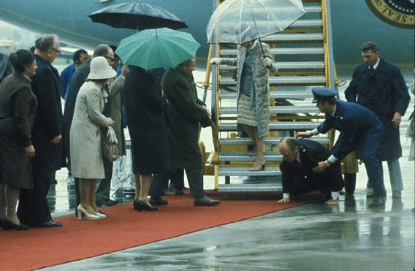
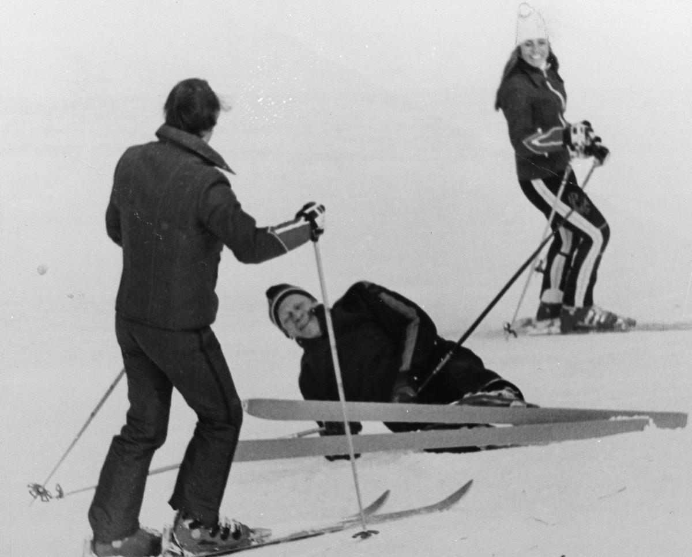
https://www.youtube.com/watch?v=_bvxZgCryUE
https://www.youtube.com/watch?v=nEIpAIqzbTg

Slide 13
Task Two: Gerald Ford
What was the leadership style, successes and failures of Ford’s presidency?
Complete the profile page using the handout.
Challenge:
How far did Ford manage to restore the reputation of the presidency?

Slide 14
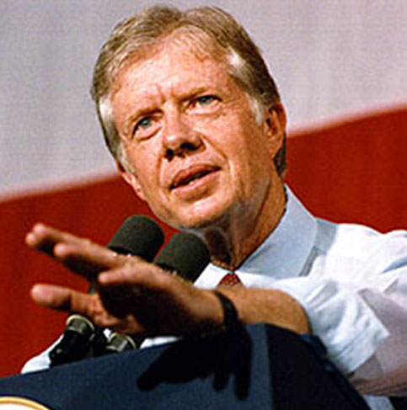
Jimmy Carter
Carter defeated Ford in the 1976 election by over 2 million votes.

Slide 15
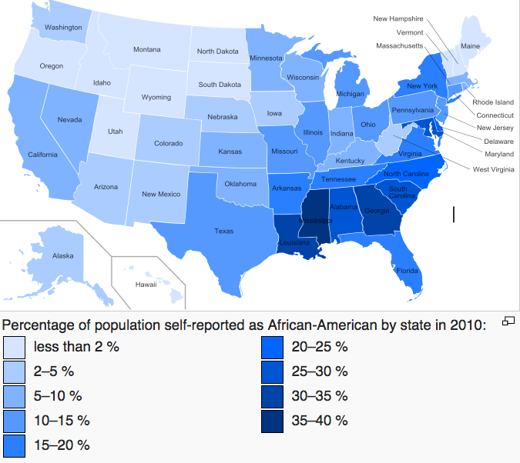

Slide 16
Why Carter?
As governor of Georgia, Carter announced that "the time for racial discrimination is over" and during his period of office (1970-74) he increased the number of African Americans employed by the state from less than 3 to 40 per cent.
Carter was the first president from the Deep South since 1844. His record of civil rights resulted in him being supported by four out of every five African Americans who voted.
He also did well with whites in the South and Americans on low incomes.

Slide 17
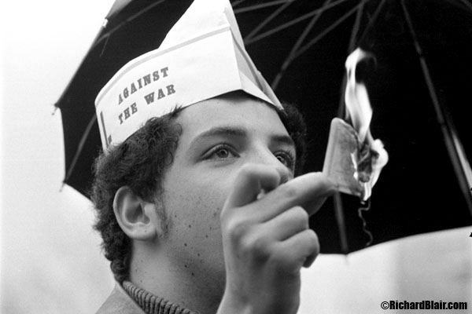
And
During the presidential campaign Carter made unemployment a central issue and announced plans to create jobs by increased federal spending.
He also promised to pardon draft evaders from the Vietnam War.

Slide 18
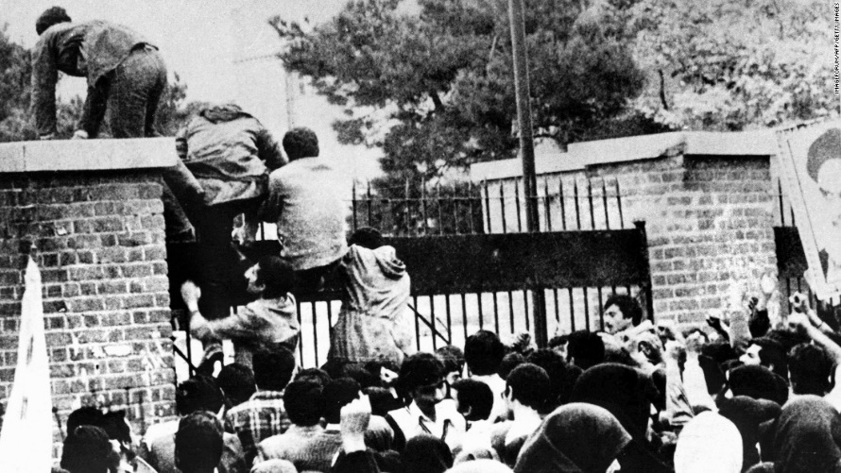
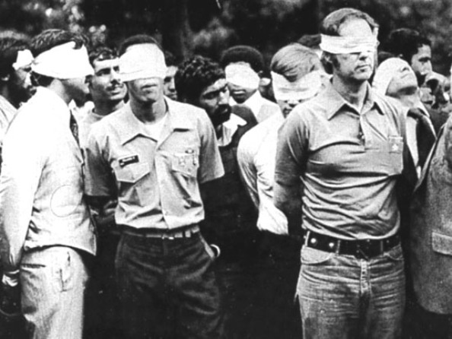
But.....
Despite some successes Carter could not end America’s economic problems. The whole world was in economic trouble caused by oil prices and instability in the Middle East.
Then in 1979 the American Embassy in Tehran, the capital of Iran was seized, and 52 Americans taken hostage.
The Iranians demanded the release of their former leader the Shah of Iran so that he could face trial.

Slide 19
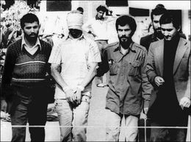
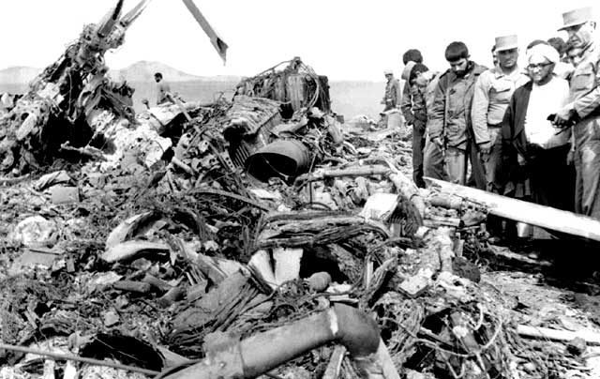
Disaster, 1979
Firstly Carter introduced economic sanctions, but these were too slow for many Americans.
He then authorised an armed rescue which went wrong, killing 8 American soldiers and leading to a massive drop in support.
Notes:
Hostages released 1981

Slide 20
The end of the road
Carter’s approval rating in the summer of 1980 was 21%, the lowest ever recorded.
By the end of the year inflation was at 15%.

Slide 21
Task Three: Jimmy Carter
What was the leadership style, successes and failures of Carter’s presidency?
Complete the profile page using the handout.
Challenge:
How far did Carter manage to restore the reputation of the presidency?

Slide 22
How far did Ford and Carter restore faith in the presidency?
Final task:
Return to the first two pages of the booklet.
-Why did we not read this at the start?
-How could you make use of this first page at home (wider reading)?
2. Complete the four sentence stems on page 2 to answer the exam style question.
3. Why is this exercise misleading? What is missing?

