Slide 1


Paper One: Q1
Quick Start: Recap
Stick the WWI Knowledge Organiser
What was the ‘Western Front’?
Describe the shape / organisation of the trench system
Name three types of poisonous gas used during WWI
Describe:
  One military development / tactic at the Battle of Cambrai
  One medical development at the Battle of Cambrai
Correct in green pen
Challenges:
Explain why the First World War a catalyst for developments in medicine and surgery.
List four advances / new techniques which were brought about during WWI
Notes:
1. Quick Start (PI: 1, 10)
“We ensure students have a quick and focused start to lessons, and we use this time for recap and retrieval practice”
Teacher stands on the threshold to monitor the corridor.
Teacher greets students at the door with a smile, and a positive comment.
Once student steps inside classroom, they are focused and in silence.
Teacher has an instantaneous 5 step activity for students to do. In most cases these will be 5 questions of spaced practice in style to recap and recall learning.
Students work silently and do not ask questions whilst the teacher completes the register.
The teacher goes through answers quickly so the quick start lasts no more than 5 minutes using effective questioning techniques and checking for understanding or misconceptions.
Odd one out / T or F / 5 Qs / KW match up / fact match up / definitions / timeline match up

Slide 2
Correct in green pen
Quick Start: Recap
Stick the WWI Knowledge Organiser
What was the ‘Western Front’?
Describe the shape / organisation of the trench system
Name three types of poisonous gas used during WWI
Describe:
  One military development / tactic at the Battle of Cambrai
  One medical development at the Battle of Cambrai
/ 5
The line of trenches along France and Belgium in WWI
Zig-Zag = Defensive
Support & reserve trenches
Chlorine, 1915 – death by suffocation; no gas masks yet
Phosgene, later 1915 – faster; killed in 2 days
Mustard, 1917 – 12 hours; external & internal blisters; burns
First large-scale use of tanks; 500 tanks
First blood depot (bank) – Robertson – Type 0; 26-8 days

Slide 3
Challenges:
Explain why the First World War a catalyst for developments in medicine
List four advances / new techniques which were brought about during WWI
Conditions:
Infectious & pressured environment
Technology:
Industrial weaponry; new injuries
SCALE:
High number of injuries
Soaking tissue in saline (salt) solution
[antiseptic]
Necessity / urgency Improvisation of new techniques = accelerated advancements
Brain surgery
Cushings magnets
Plastic surgery unit Harold Gillies - Sidcup
Government funded x-ray machines
Roentgen 1895
Blood storage (citrate glucose solution)
First Blood Depot 1917 Cambrai
Broken limbs
Thomas Splint

Slide 4
Paper One Q1
underlined
LOs:
1. To clarify and know what is being assessed in the final assessments
2. To know where to find revision resources and support
3. To model and practice Paper One Q1 ‘Describe two features of....’ [4]
Notes:
2. Lesson Intentions (PI: 2)
“We ensure students are clear about what they are learning within each lesson”
What do I want students to know?
What do I want students to understand?
What do I want students to be able to do?

Slide 5
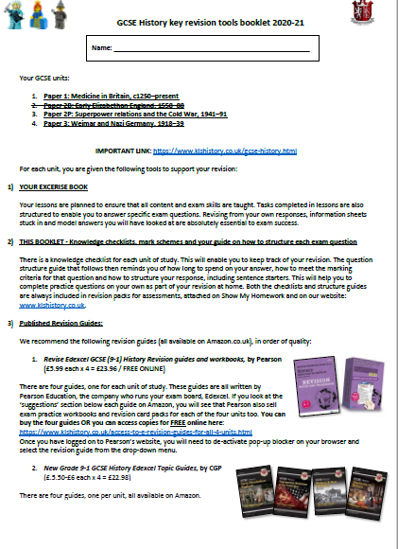
What is being assessed in the final assessments?
Course Guide
Find the overview grid of the original exams for GCSE History on page 5 of your course guide.

Slide 6
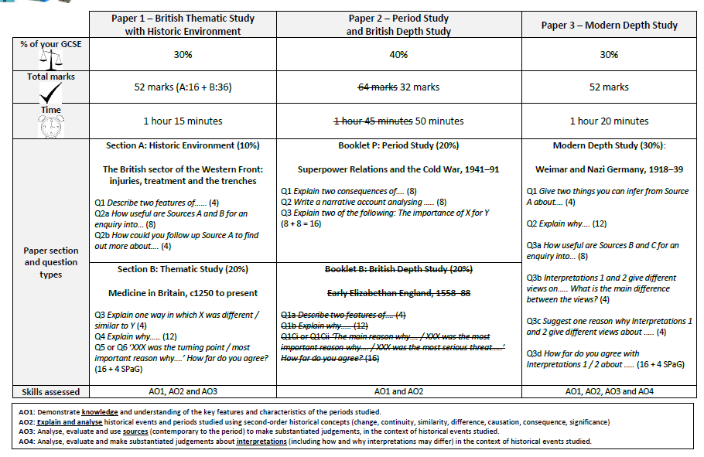
Originally....

Slide 7
What’s changed:
Paper 1 - Medicine in Britain, c1250 to present & The British sector of the Western Front: injuries, treatment and the trenches
All questions
All content
Paper 2 - Superpower relations and the Cold War, 1941–58
Question 1 and Question 2 ONLY
Unit 1 (Origins of the Cold War) 1941-58.
Paper 3 - Weimar and Nazi Germany, 1918–39​
Questions 1, 2, 3a & 3b ONLY
Unit 1 (Weimar Republic 1918-29)
Unit 2 (Hitler’s Rise to Power 1919-33)
Where would you find this information?

Slide 8
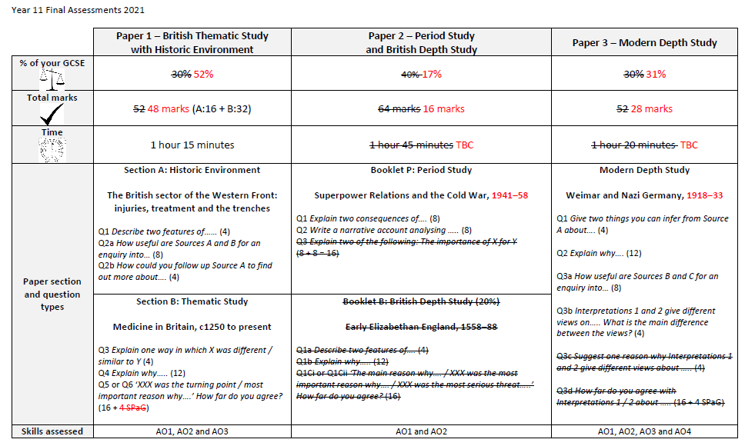
What’s changed:
Course Guide
Annotate your table on page 5 of your course guide.

Slide 9
Where to find revision resources and support
https://www.klshistory.co.uk/

Slide 10
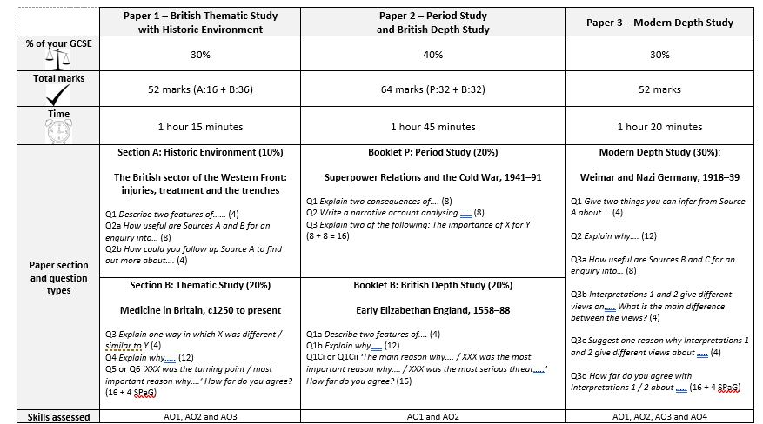
Paper 1 Section A

Slide 11
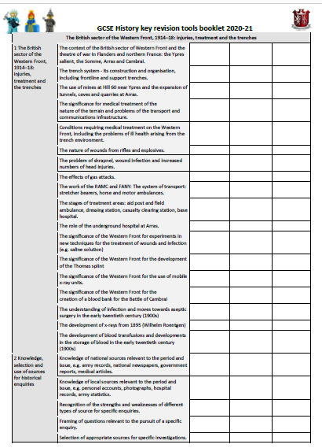
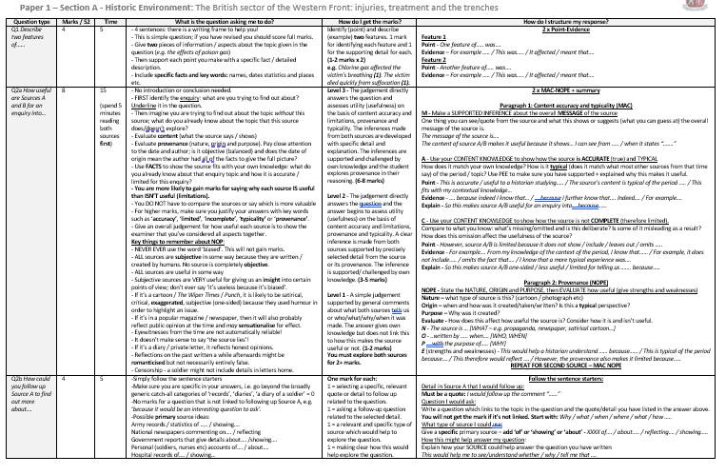
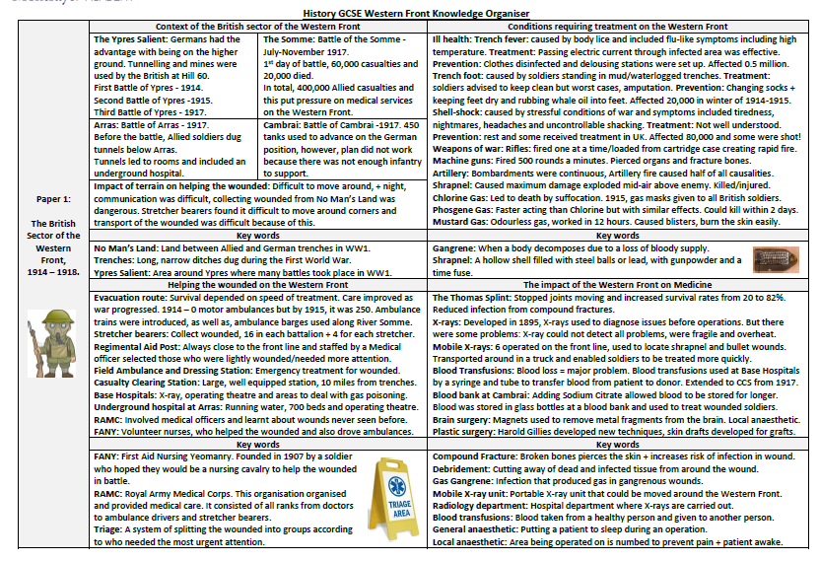
Always use to practice:
Knowledge Checklist (course guide)
Exam Q Guide (course guide)
Knowledge Organiser

Slide 12
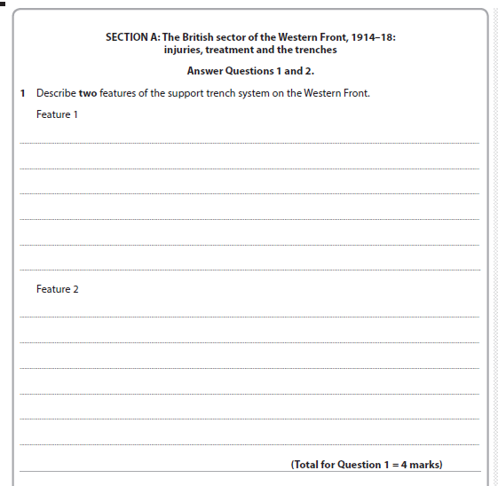
In bold to remind you
Q1 Describe two features of...... [4]
Facts
Writing frame!
How many marks?
How many sentences, as a general rule?
How many minutes?
FOUR
FOUR
FIVE

Slide 13
Q1 Describe two features of...... [4]
Level | Mark | Descriptor
Level 1 | 1-2 x2 | Identify (point) Describe (example) two features. 1 mark for identifying each feature and 1 for the supporting detail for each. e.g. Chlorine gas affected the victim’s breathing (1). The victim died quickly from suffocation (1).
Give two pieces of information / aspects about the topic given in the question (e.g. the effects of poison gas)
Then support each point you make with a specific fact / detailed description. Include specific facts and key words: names, dates statistics and places etc.
Feature 1
Point - One feature of….. was….
Evidence – For example ….. / This was….. / It affected / meant that….
Feature 2
Point - Another feature of….. was….
Evidence – For example ….. / This was….. / It affected / meant that….

Slide 14
The support trench system consisted of support trenches as its main feature. These support trenches were so metres back from the frontline trenches and could be connected to the frontline via communication trenches. These were made for soldiers to retreat into if the frontline was under attack.
Another feature of support trenches was that due to their distance from the frontline they were much safer and could be used to store artillery or even for the mobilisation of larger reserve troops thanks to this safety feature.

Slide 15
Q1 Describe two features of...... [4]
Mock strengths
Lots of high/full marks
Most attempted
Tried to specific examples
Improvement areas
Some did not attempt
Repetition - 2nd feature was the same as 1st
Irrelevant facts not related to the Battle of Cambrai (although still better than writing nothing)
Level | Mark | Descriptor
Level 1 | 1-2 x2 | Identify (point) Describe (example) two features. 1 mark for identifying each feature and 1 for the supporting detail for each. e.g. Chlorine gas affected the victim’s breathing (1). The victim died quickly from suffocation (1).
How could you revise for this question?

Slide 16
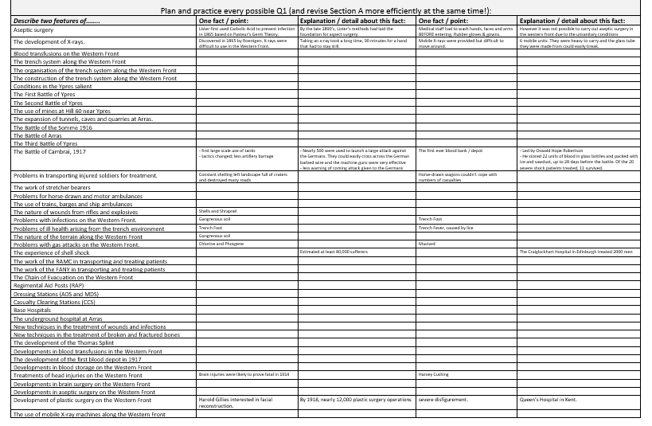

Slide 17
Q1 Describe two features of the first blood depot at the Battle of Cambrai [4]
One feature of the first blood depot at the Battle of Cambrai was the successful refrigeration and storage of blood.
..... units of blood were stored in..... and could be used for.......
Another feature was the use of Type O blood.
This meant that….
OR
Another feature was The success of Robertson’s methods.
Of the 20 Canadian soldiers treated ......

Slide 18
Q1 Describe two features of the first blood depot at the Battle of Cambrai [4]
One feature of the first blood depot at the Battle of Cambrai was the successful refrigeration and storage of blood.
22 units of blood were stored in glass bottles and packed with ice and sawdust, and could be used for up to 28 days.
Another feature was the use of Type O blood. This meant that all patients could receive the blood because it is a universal blood type, as identified by Karl Landsteiner in 1901.
Another feature was The success of Robertson’s methods.
Of the 20 Canadian soldiers treated, 11 survived.

Slide 19
Q1 Describe two features of gas attacks on the Western Front [4]
One feature of ....was.....
This led to....
Another feature was .....
This caused.....

Slide 20
Q1 Describe two features of gas attacks on the Western Front [4]
One feature of gas attacks on the Western Front was the use of chlorine gas early in 1915.
This led to death by suffocation, made worse by the lack of gas masks to begin with, and later the use of phosgene gas.
Another feature was the use of mustard gas in 1917, a much more deadly and painful odourless gas.
This caused both internal and external blisters, could pass through clothing to burn the skin, and worked at speed within 12 hours.

Slide 21
Q1 Describe two features of ...... on the Western Front [4]
One feature of ....was.....
For example.... / This caused / affected / led to / meant that ...
Another feature was .....
For example.... / This caused / affected / led to / meant that ...

Slide 22

I need...

Slide 23
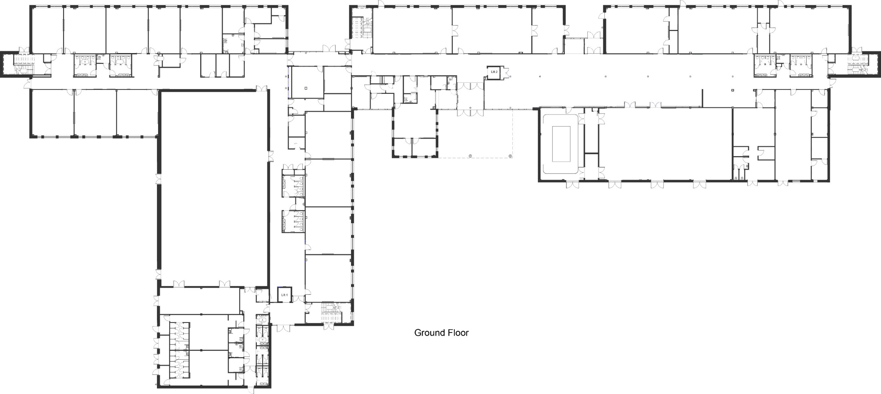

Back Entrance to Building B
Exit to Building B
Back Entrance to Building A
West
Stairs
Up
Only
North Stairs Down Only
East Stairs
Up Only
Exit Only
Front Entrance to Building A
South
Stairs
Down
Only
Front Entrance to Building B

Slide 24
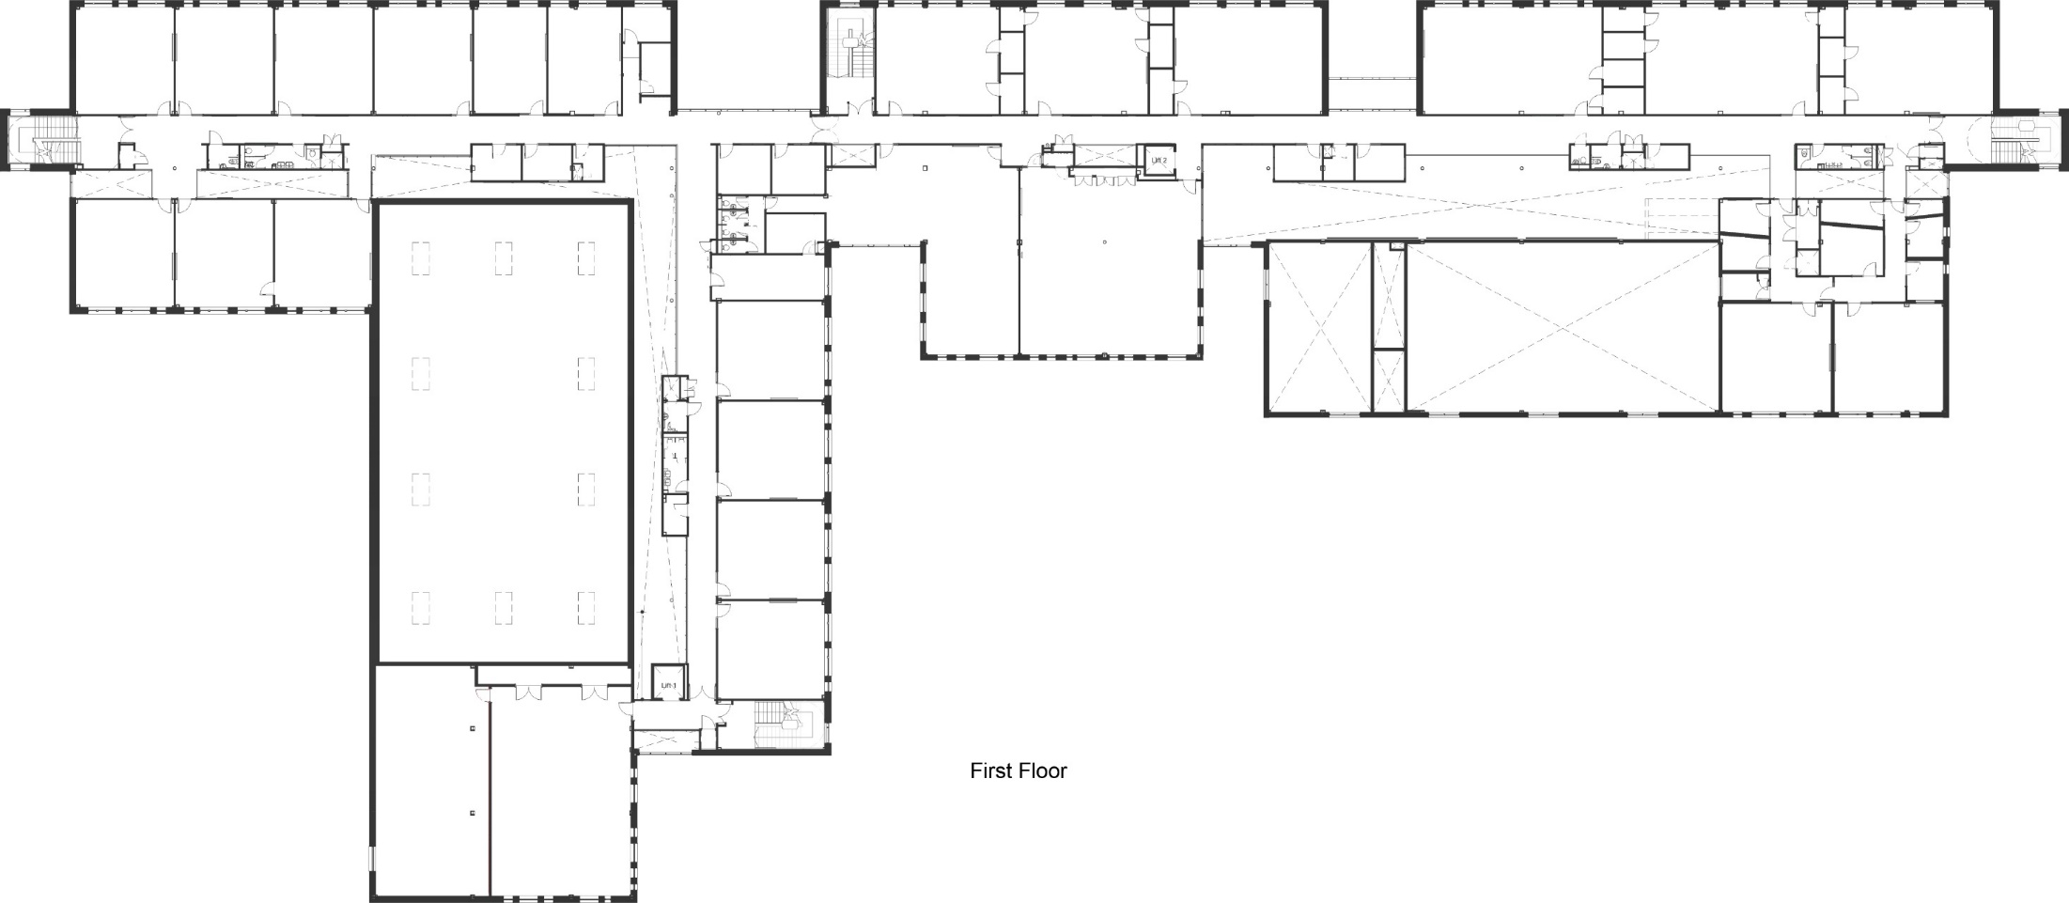
North Stairs Down Only
West
Stairs
Up
Only
East Stairs Up Only
South Stairs Down Only

Slide 25
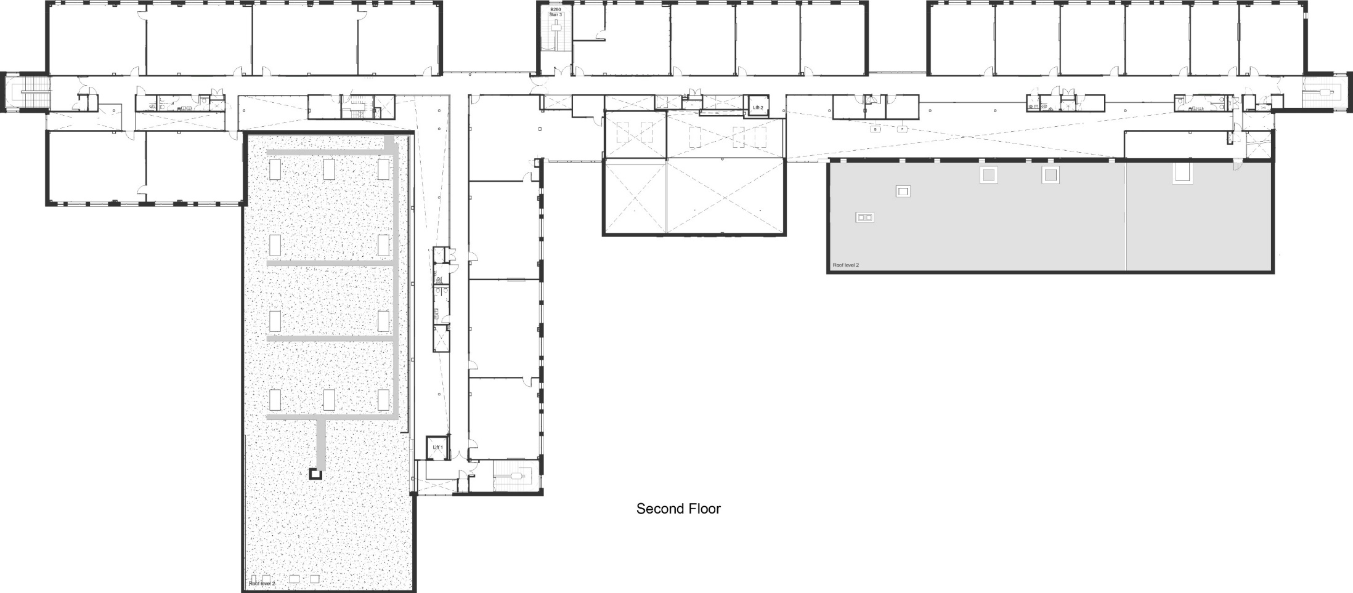
North Stairs Down Only
West
Stairs
Up
Only
East Stairs Up Only
South Stairs Down Only

