Slide 1

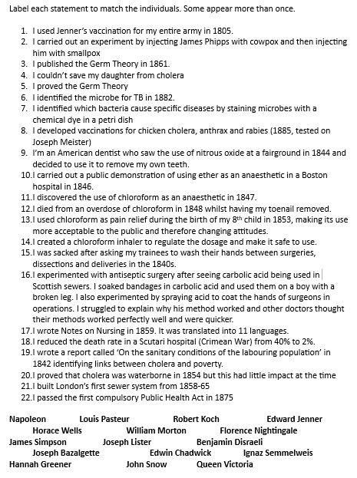

Paper 1 Essay Questions
Quick Start: Recap
Label each statement to match the individuals. Some appear more than once.
Just use their initials.
Correct in green pen.
Challenge: Which individual had the biggest impact on medicine and why? Use ‘first’ in your answer.
Notes:
1. Quick Start (PI: 1, 10)
“We ensure students have a quick and focused start to lessons, and we use this time for recap and retrieval practice”
Teacher stands on the threshold to monitor the corridor.
Teacher greets students at the door with a smile, and a positive comment.
Once student steps inside classroom, they are focused and in silence.
Teacher has an instantaneous 5 step activity for students to do. In most cases these will be 5 questions of spaced practice in style to recap and recall learning.
Students work silently and do not ask questions whilst the teacher completes the register.
The teacher goes through answers quickly so the quick start lasts no more than 5 minutes using effective questioning techniques and checking for understanding or misconceptions.
Odd one out / T or F / 5 Qs / KW match up / fact match up / definitions / timeline match up

Slide 3
Paper 1 Essay Questions
It’s a question, so it needs a ?
underlined
LOs:
1. To know how to plan for these essay questions in revision
2. To practice L4 judgements of relative importance
3. To practice developing examples fully
Notes:
2. Lesson Intentions (PI: 2)
“We ensure students are clear about what they are learning within each lesson”
What do I want students to know?
What do I want students to understand?
What do I want students to be able to do?

Slide 4
Mocks
Strengths
Content revision
Lengthy answers
Detailed examples
Structured responses
Full papers
Improvement areas
Overall judgements
Lead with factors not examples
Prioritising Q5/6 in Paper 1
Hitting top level marks
Source / interpretation Qs

Slide 5
Mark / 132 | % | Level (2019 GB)
0 | 0 | U
10 | 7.7 | 1
26 | 19.6 | 2
42 | 31.5 | 3
58 | 44 | 4
69 | 52.4 | 5
80 | 60.7 | 6
91 | 69 | 7
101 | 76.8 | 8
112 | 84.5 | 9

Slide 6
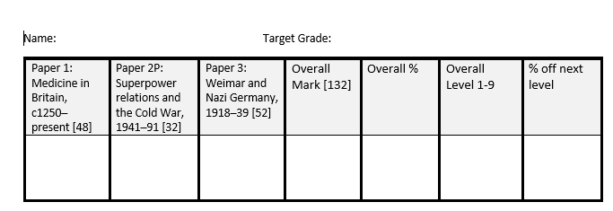

Slide 7
Task One: Mock analysis
Spend time reading through your mocks, then complete the following in full sentences in your book:
My strengths were......
My areas for improvement were.....
Mistakes I made were....
Next time, I should....
The question I did best on was....
This was because....
The paper I did least well on was....
This was because....
Mark / 132 | % | Level
0 | 0 | U
10 | 7.7 | 1
26 | 19.6 | 2
42 | 31.5 | 3
58 | 44 | 4
69 | 52.4 | 5
80 | 60.7 | 6
91 | 69 | 7
101 | 76.8 | 8
112 | 84.5 | 9
Challenge: Explain why either Pasteur or Koch was significant (using PEE) to the development of medical understanding in the long term.
Notes:
4. Student Activity (PI: 5, 6, 8, 9)
Students must be given time for independent practice and this should be challenging, though scaffolding should be given if required
4a. Scaffolding and Challenge (PI: 4, 8)
“We have a deep understanding of our subject knowledge and are able to challenge all students’ thinking, whilst scaffolding the learning for students that require it to reach the best outcome”
4b. Guided Independent Practice (PI: 5, 9)
“We provide significant time for students to independently practice, guiding them and supporting them as they make progress”

Slide 8
Challenge: Explain why either Pasteur or Koch was significant (using PEE) to the development of medical understanding in the long term.
Louis Pasteur was significant because he discovered that germs caused diseases. This was significant because it disproved incorrect theories about the causes of disease that had been relied upon by physicians since the Roman era. For example, it disproved ‘spontaneous generation, miasma and the Theory of the Four Humours. It also meant that people could become less reliant on religion for explaining disease. Once the real cause of disease was understood, doctors and surgeons could begin to effectively prevent and treat disease. For example, Joseph Lister was able to prove that germs caused infection after surgery. Even today, hospitals rely on Pasteur’s work to prevent infections and their staff have to follow strict regulations as to how to wash their hands effectively; ‘catch it, bin it, kill it’.
Pasteur’s work was also significant because he was able to extend the work of Robert Koch and Edward Jenner to create vaccines for multiple diseases. Jenner had discovered the vaccine for smallpox in 1796, but could not explain exactly how the vaccination worked. However, once Pasteur had discovered that bacteria caused diseases and once Robert Koch had extended this work by staining and identifying which microbes caused which diseases, Pasteur was then able to apply Jenner’s work to other diseases. For example, Pasteur created a vaccine for anthrax and chicken cholera, then rabies in 1885, on Joseph Meister, a boy who had been bitten by a rabid dog. Other scientists then created vaccinations for typhoid (1896), TB (1906) and Diphtheria (1913) by copying Pasteur’s methods. So, Pasteur’s work on vaccinations is highly significant because it paved the way for the vaccination programmes we use today. Vaccinations are widely accepted and many are compulsory by law, made available by the NHS. Young children for example have the MMR (Measles, Mumps and Rubella) vaccination provided at school.

Slide 9
Challenge: Explain why either Pasteur or Koch was significant (using PEE) to the development of medical understanding in the long term.
One reason why Robert Koch was significant in the development of preventing diseases is because he identified which microbes caused which diseases. Louis Pasteur had published his Germ Theory in 1861. Koch then extended this work by using dyes to stain different microbes in a petri dish, to identify individual disease microbes. For example, in 1875 Koch found microbes that could be linked to anthrax in sheep. Then, in 1882, he identified the microbe for Tuberculosis, TB. This was significant because now other scientists could use his methods to identify other disease microbes, for example cholera in 1883, pneumonia in 1886 and meningitis in 1887.
His work also then led to Pasteur’s development of vaccines for multiple diseases. Pasteur had tried to investigate the specific microbes causing cholera in 1865 for example, but was unable to see these under a microscope. However, Koch’s work then meant that Pasteur could create vaccines, weak doses of the disease to create immunity. Pasteur first created a vaccine for anthrax and chicken cholera, then rabies in 1885. Other scientists then created vaccinations for typhoid (1896), TB (1906) and Diphtheria (1913). So, Koch’s work was significant because it enabled the development of vaccinations, the most effective prevention of disease that we still use today. Vaccinations are widely accepted and many are compulsory by law, made available by the NHS. Young children for example have the MMR (Measles, Mumps and Rubella) vaccination provided at school.

Slide 10
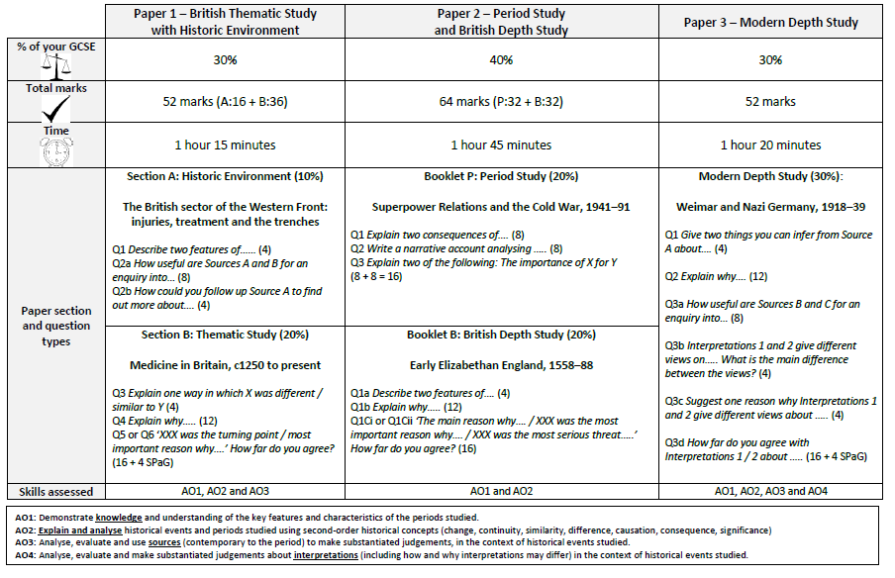
Q5/6
Xxx was the most important factor / individual ..
....for progress / lack of progress
...in the causes / treatment / prevention of diseases / public health
....during the period XXX [only 4 – Medieval, Renaissance, Industrial or Modern]

Slide 11
Based on your mock...
Do this Q first
Answers should fill the pages available
Examples must be detailed – dates, names
Judgements need to weigh up the importance of different factors / individuals

Slide 12
How do I answer the essay question in this paper?
4x PEEL
Without….
If…then……

Slide 13
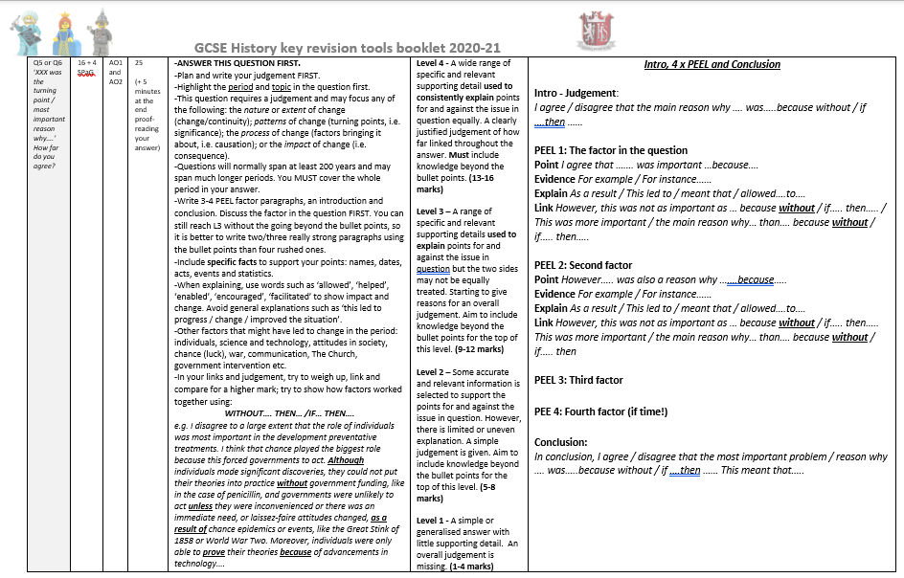

Slide 14
Medicine Q5/6 Essay Question
Wording: ‘XXX was the turning point / most important reason why….’ How far do you agree?
16 marks + 4 SPaG
Spend 25 minutes + 5 minutes proof-reading your answer
We always suggest you do this question first in the paper.

Slide 15
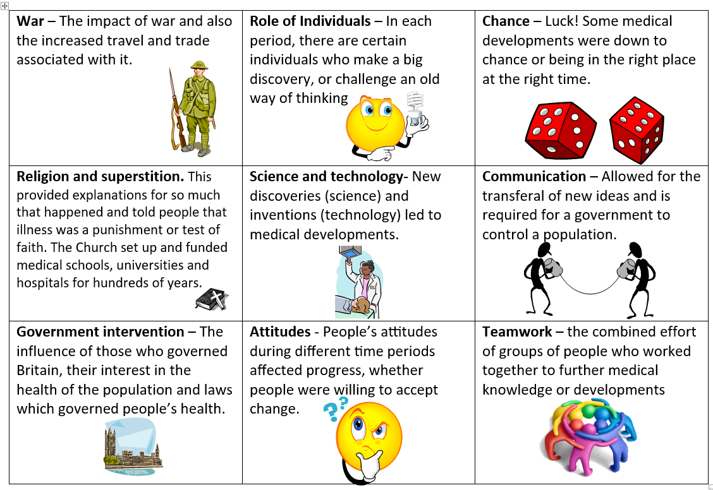

Slide 16
“Individuals had the greatest impact on the development of understanding about the causes of disease in Britain during the 19th century”. How far do you agree with this statement?
You may use the following in your answer:
Louis Pasteur
Communication

Slide 17
“Individuals had the greatest impact on the development of understanding about the causes of disease in Britain during the 19th century”. How far do you agree with this statement?
You may use the following in your answer:
Louis Pasteur
Communication
Task:
Decode the question
List at least 5 OTHER factors that you could discuss in this question:
Individuals
2) Then code the examples below to support your factors. Use letters to code each - e.g. I = Individuals
Science & Technology
Challenge:
What links can you make between these factors?
Write your judgement (your answer to the question) in your book. Use ‘without’.
Attitudes
War
Government intervention
Luck/chance
Teamwork
Communication
Notes:
4. Student Activity (PI: 5, 6, 8, 9)
Students must be given time for independent practice and this should be challenging, though scaffolding should be given if required
4a. Scaffolding and Challenge (PI: 4, 8)
“We have a deep understanding of our subject knowledge and are able to challenge all students’ thinking, whilst scaffolding the learning for students that require it to reach the best outcome”
4b. Guided Independent Practice (PI: 5, 9)
“We provide significant time for students to independently practice, guiding them and supporting them as they make progress”

Slide 18
“Individuals had the greatest impact on the development of understanding about the causes of disease in Britain during the 19th century”.
How far do you agree with this statement?
Intro, 4 x PEEL and Conclusion
Intro - Judgement: I agree / disagree that the main reason why …. was…..because without / if ….then ……
PEEL 1: The factor in the question
Point I agree that ……. was important …because….
Evidence For example / For instance……
Explain As a result / This led to / meant that / allowed….to….
Link However, this was not as important as … because without / if….. then….. / This was more important / the main reason why… than…. because without / if….. then…..
PEEL 2: Second factor
Point However….. was also a reason why …….because…..
Evidence For example / For instance……
Explain As a result / This led to / meant that / allowed….to….
Link However, this was not as important as … because without / if….. then…..
This was more important / the main reason why… than…. because without / if….. then
PEEL 3: Third factor
PEE 4: Fourth factor (if time!)
Conclusion: In conclusion, I agree / disagree that the most important problem / reason why …. was…..because without / if ….then …… This meant that…..

Slide 19
Example PEEL
Individuals were important because they developed each others work to identify causes of disease and then vaccinations.
For example, Louis Pasteur identified germs as the cause of disease in 1861, which disproved ‘spontaneous generation, miasma and the Theory of the Four Humours. Koch also extended the work of Pasteur by proving his Germ Theory scientifically, identifying the specific microbes causing specific diseases by staining these individually in a petri dish, such as TB in 1882. Pasteur was then able to use the work of Robert Koch and Edward Jenner to create vaccines for multiple diseases. For example, Pasteur created a vaccine for anthrax and chicken cholera, then rabies in 1885, on Joseph Meister, a boy who had been bitten by a rabid dog.
The work of these individuals led to significant medical progress in identifying the causes of diseases because, once the real cause of disease was understood, doctors and surgeons could begin to effectively prevent and treat disease. For example, Joseph Lister was able to prove that germs caused infection after surgery and developed the use of carbolic acid to prevent infection. Without Pasteur and Koch’s work on germs, antiseptic methods and aseptic conditions could not have been developed, as Lister would not have had the theory to explain why his methods worked. Pasteur’s link between Koch and Jenner’s work also led to further vaccinations being created; he was able to explain how they worked where Jenner had not been able to in 1796. Other scientists created vaccinations for typhoid (1896), TB (1906) and Diphtheria (1913) by copying Pasteur’s methods.
Although this is a significant factor, I disagree that it was the main factor. I believe that public attitudes were in fact the most significant factor because without public acceptance of these new theories, they had little impact outside of the scientific community.

Slide 20
“Individuals had the greatest impact on the development of understanding about the causes of disease in Britain during the 19th century”. How far do you agree with this statement?
You may use the following in your answer:
Louis Pasteur
Communication
Level 4 - A wide range of specific and relevant supporting detail used to consistently explain points for and against the issue in question equally. A clearly justified judgement of how far linked throughout the answer. Must include knowledge beyond the bullet points. (13-16 marks)
Level 3 – A range of specific and relevant supporting details used to explain points for and against the issue in question but the two sides may not be equally treated. Starting to give reasons for an overall judgement. Aim to include knowledge beyond the bullet points for the top of this level. (9-12 marks)
Level 2 – Some accurate and relevant information is selected to support the points for and against the issue in question. However, there is limited or uneven explanation. A simple judgement is given. Aim to include knowledge beyond the bullet points for the top of this level. (5-8 marks)
Level 1 - A simple or generalised answer with little supporting detail. An overall judgement is missing. (1-4 marks)

Slide 21

“Individuals had the greatest impact on the development of understanding about the causes of disease in Britain during the 19th century”.
How far do you agree with this statement?
Agree
Strongly Agree
You cannot sit on the fence!
Disagree
Strongly Disagree

Slide 22
‘Jenner’s vaccination against smallpox was a major breakthrough in the prevention of disease in Britain during the period c1700–c1900.’ How far do you agree? Explain your answer. [16 MARKS]
You may use the following in your answer:
Cowpox
Germ Theory
You must also use information of your own.
Q suggests J’s vaccination is most important.
‘major breakthrough’?
Focus only on preventions c.1700-1900 [industrial period]
Give extent [amount] in your answer

Slide 23
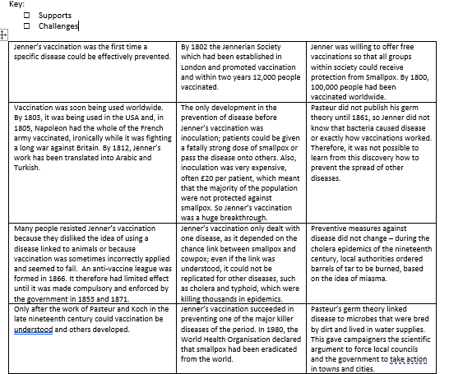
Tasks:
1. Read through the evidence and shade/mark to indicate whether the statements support or challenge the statement in the question.
2. Now read the two example paragraphs. Explain what you think is good and what could be done to improve each paragraph. You may wish to code the paragraph to indicate PEE (optional)
+
_
Challenge: Use the essay plan to start writing
+
Notes:
4. Student Activity (PI: 5, 6, 8, 9)
Students must be given time for independent practice and this should be challenging, though scaffolding should be given if required
4a. Scaffolding and Challenge (PI: 4, 8)
“We have a deep understanding of our subject knowledge and are able to challenge all students’ thinking, whilst scaffolding the learning for students that require it to reach the best outcome”
4b. Guided Independent Practice (PI: 5, 9)
“We provide significant time for students to independently practice, guiding them and supporting them as they make progress”

Slide 24
+
_
+
+
+
-
+
-
-
-
-
- / +
+
+ / -

Slide 25
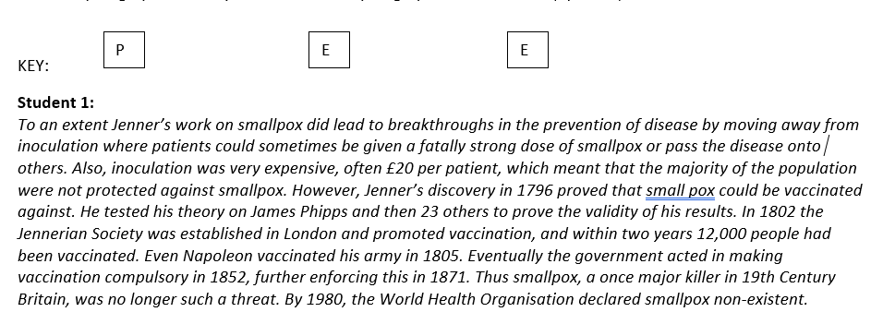
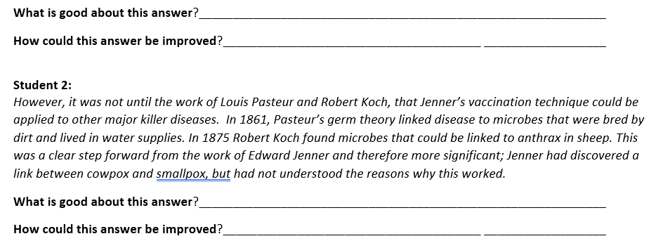

Slide 26
Penicillin
Task : Exam question
Begin annotating (labelling) parts of the question to work out what you need to do.
“The main reason that penicillin was developed in the early 20th century was because of the work of individuals.”
Do you agree? You may use the following:
Alexander Fleming
WWII
You must also use information of your own.

Slide 27
The question says Individuals was the main factor
I need to explain how and why penicillin was developed
“The main reason that penicillin was developed in the early 20th century was because of the work of individuals.”
Do you agree? You may use the following:
Alexander Fleming
WWII
You must also use information of your own.
Example of a second factor - war
Need to add a third factor – Government?
1900s
Example of an individual that both helped and hindered

Slide 28

Which factors could you use?
Copy as a key:
G = Government funding
T = Technology
Com = Communication
W = War
S = Scientific understanding
I = Role of Individuals
CL = Chance/Luck

Slide 29
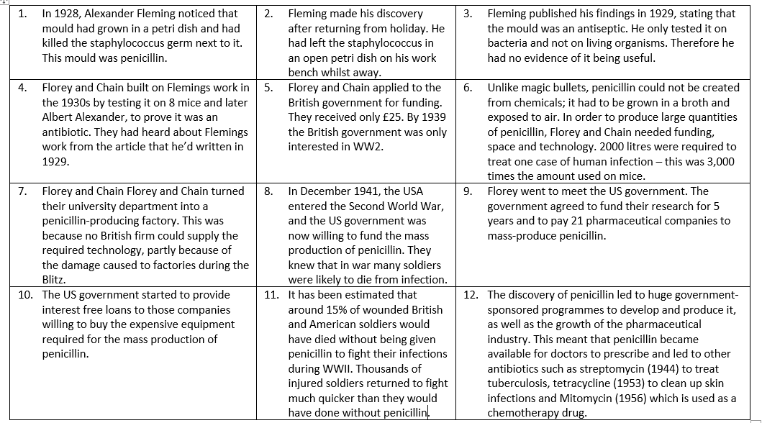
Task: Write down at least one factor for each example. This can be a factor that helped OR hindered development. Write the letter and the factor(s). E.g. 1 = I + S
G = Government funding
T = Technology
Com = Communication
W = War
S = Scientific understanding
I = Role of Individuals
CL = Chance/Luck
Challenge: “Government intervention (action) was the most important factor in the development of penicillin”. How far do you agree?

Slide 30
Task One: Write down at least one factor for each example. This can be a factor that helped OR hindered development. Write the letter and the factor(s). E.g. 1 = I + S
G = Government funding
T = Technology
Com = Communication
W = War
S = Scientific understanding
I = Role of Individuals
CL = Chance/Luck
Correct in green pen.
I + S
CL
Com + S
I + Com + S
G + W
S + T
I + T + W
G + W
G + W + I
G + T
W
G + S + T

Slide 31
G
1
2
3
4
Task: Making links
Write out the FOUR factors below on at least half of a page.
Draw arrows to show links between these factors – how did they work together to help develop penicillin?
Write a brief explanation above/next to the arrow.
1. The role of individuals
2. War
Florey travelled to the USA to ask for funding
3. Government funding
4. Science and technology

Slide 32
WWI was when Fleming first began studying staphylococcus
1. The role of individuals
2. War
Prevented British companies from providing F&C with the technology they needed to mass produce penicillin – this is why they had to do it themselves.
Florey travelled to the USA to ask for funding
War provided an urgent reason = gov willing to fund large scale production
F&C used scientific methods and tests to prove it was an antibiotic
3. Government funding
4. Science and technology
Provided the funding to pay for the tech needed

Slide 33
Q5/6 Mark scheme
PEEL: Well explained and always linked back to judgement / other factors
Level 4 - A wide range of specific and relevant supporting detail used to consistently explain points for and against the issue in question equally. A clearly justified judgement of how far linked throughout the answer. Must include knowledge beyond the bullet points. (13-16 marks)
Level 3 – A range of specific and relevant supporting details used to explain points for and against the issue in question but the two sides may not be equally treated. Starting to give reasons for an overall judgement. Aim to include knowledge beyond the bullet points for the top of this level. (9-12 marks)
Level 2 – Some accurate and relevant information is selected to support the points for and against the issue in question. However, there is limited or uneven explanation. A simple judgement is given. Aim to include knowledge beyond the bullet points for the top of this level. (5-8 marks)
Level 1 - A simple or generalised answer with little supporting detail. An overall judgement is missing. (1-4 marks)
PEE: Specific examples fully explained using words of the question.
Starting to explain, but waffly. Some specific examples
A list of general examples or points

Slide 34
Task: “The main reason that penicillin was developed in the early 20th century was because of the work of individuals.”
Do you agree?
I agree / strongly agree with this statement because without government intervention, …..
Agree
Strongly Agree
You cannot sit on the fence!
I disagree / strongly disagree with this statement. I think that the most important factor was….because without [factor] …..
Disagree
Strongly Disagree

Slide 35
Example conclusion:
I disagree to a large extent that the role of individuals was most important in the development of penicillin. I think that chance played the biggest role because this forced governments to act. Although individuals made significant discoveries, they could not put their theories into practice without government funding, and governments were unlikely to act unless they were inconvenienced or there was an immediate need, as a result of chance events, like World War Two. Moreover, individuals were only able to prove their theories because of advancements in technology….

Slide 36
Q5/6 Essay Structure
Intro, 4 x PEEL and Conclusion
Intro - Judgement: I agree / disagree that the main reason why …. was…..because without / if ….then ……
PEEL 1: The factor in the question
Point I agree that ……. was important …because….
Evidence For example / For instance……
Explain As a result / This led to / meant that / allowed….to….
Link However, this was not as important as … because without / if….. then….. / This was more important / the main reason why… than…. because without / if….. then…..
PEEL 2: Second factor
Point However….. was also a reason why …….because…..
Evidence For example / For instance……
Explain As a result / This led to / meant that / allowed….to….
Link However, this was not as important as … because without / if….. then…..
This was more important / the main reason why… than…. because without / if….. then
PEEL 3: Third factor
PEE 4: Fourth factor (if time!)
Conclusion: In conclusion, I agree / disagree that the most important problem / reason why …. was…..because without / if ….then …… This meant that…..

Slide 37
“The main reason that penicillin was developed in the early 20th century was because of the work of individuals.” Do you agree? You may use the following:
Alexander Fleming
WWII
You must also use information of your own.
Task: Exam question
3. Write your introduction. This must include your judgement.
4. Write one PEEL paragraph about Individuals / War / Government
Intro - Judgement:
I agree / disagree that the main reason why ….was… because without/if ….then ..
PEEL – Individuals / War / Government
Point The factor of ......was important because.... [why did this factor help?]
Evidence For example / For instance…… [describe what happened]
Explain As a result / This led to / meant that / allowed….to…. [how did it lead to the mass-production of penicillin?]
Link However, this was not as important as … because without / if….. then….. / This was more important than…. because without / if….. then….. [was this more or less important factor than another?]

Slide 38
Example PEEL – Scientific understanding
Point The factor of scientific understanding was also important because it led to the proof that penicillin was an antibiotic.
Evidence For example, it was Fleming’s scientific research and understanding of staphylococcus that led him to make his accidental discovery in 1928. In the early 20th century, scientists had moved towards lab-based medicine, and research was carried out using samples by microbiologists (rather than doctors). Fleming had been investigating the bacteria in a lab in petri dishes. However, his assumption that the mould was an antiseptic rather than an antibiotic delayed progress, as it meant that he did not test it on living organisms. In the 1930s, Florey and Chain used a number of lab-based scientific methods to prove that penicillin had antibiotic properties, such as their experiment on 8 mice. They used 4 mice as a control group and injected it into the other 4 mice to prove that it cured the infection. Also, they developed scientific methods of producing the penicillin ‘mould juice’; unlike magic bullets, penicillin could not be created from chemicals, as it had to be grown in a broth and exposed to air. 2000 litres were required to treat one case of human infection – this was 3,000 times the amount used on mice.
Explain The scientific methods and experiments used by all three scientists helped the development of penicillin because, firstly, they provided proof that penicillin was an antibiotic. Secondly, Florey and Chain’s methods of mass-production in their make-shift lab provided the basis for huge pharmaceutical companies to copy this process, once they’d received funding from governments. Florey and Chain were also able to prove that they would need far greater funding and technology if it were to be mass-produced, which provided the impetus for government to intervene.
Link However, this was not as important as the role of the government. Without the funding from the government, none of these scientific methods and research would have been applied on a mass scale; penicillin would have remained an unfunded antibiotic that had only been tested on one person and 8 mice.

Slide 39
Individuals / War / Government
Individuals:
Fleming’s discovery
Florey and Chain’s experiments
Florey sought the US gov’s help
War:
Fleming’s research in WWI
WWII created an urgent need for a cure
So forced the government to provide funding
How many lives did it save?
Government:
Florey and Chain received £25 from the British government
Why was this not enough?
US government gave funding for 5 years
Funded 21 pharmaceutical companies
How quickly was penicillin mass produced?
What government-funded organisation made penicillin available to everyone after WWII?

Slide 40
“The main reason that penicillin was developed in the early 20th century was because of the work of individuals.” Do you agree? You may use the following:
Alexander Fleming
WWII
You must also use information of your own.
Task four: Exam question
3. Write your introduction. This must include your judgement.
4. Write one PEEL paragraph about Individuals / War / Government
Intro - Judgement:
I agree / disagree that the main reason why ….was… because without/if ….then ..
PEEL: Individuals / War / Government
Point The factor of ......was important because.... [why did this factor help?]
Evidence For example / For instance…… [describe what happened]
Explain As a result / This led to / meant that / allowed….to…. [how did it lead to the mass-production of penicillin?]
Link However, this was not as important as … because without / if….. then….. / This was more important than…. because without / if….. then….. [was this more or less important factor than another?]

Slide 41
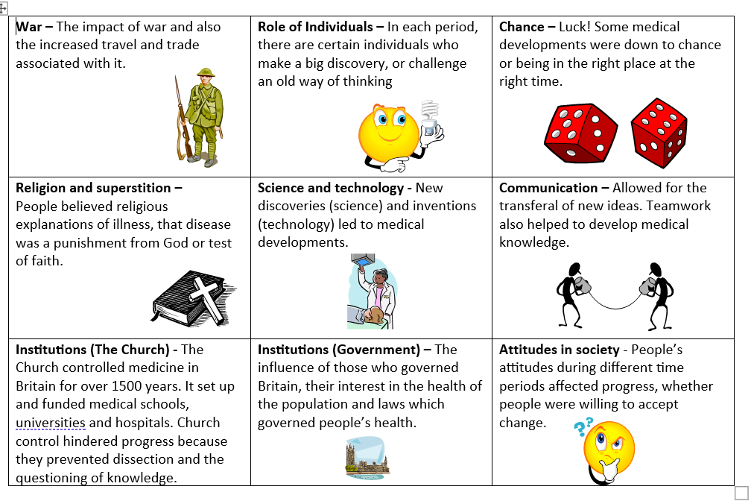
“Government action was the most important factor in improving Public Health provision in towns in the 19th Century”. How far do you agree with this statement?
The 1875 Public Health Act
Edwin Chadwick
Task:
1. Identify four factors
2. Give at least 2 examples of each

Slide 43
“Government action was the most important factor in improving Public Health provision in towns in the 19th Century”. How far do you agree with this statement?
Agree
Strongly Agree
You cannot sit on the fence!
Disagree
Strongly Disagree

Slide 44
“The main reason there was little progress in the period c1250-1700 was because of the role of the government”. How far do you agree with this statement?
Pest/pox houses
The Church
Final: Mock Q5 example answer
Strengths:
Improvement suggestions:
Mark: ________ / 16

Slide 45
Q5/6 Mark scheme
PEEL: Well explained and always linked back to judgement / other factors
Level 4 - A wide range of specific and relevant supporting detail used to consistently explain points for and against the issue in question equally. A clearly justified judgement of how far linked throughout the answer. Must include knowledge beyond the bullet points. (13-16 marks)
Level 3 – A range of specific and relevant supporting details used to explain points for and against the issue in question but the two sides may not be equally treated. Starting to give reasons for an overall judgement. Aim to include knowledge beyond the bullet points for the top of this level. (9-12 marks)
Level 2 – Some accurate and relevant information is selected to support the points for and against the issue in question. However, there is limited or uneven explanation. A simple judgement is given. Aim to include knowledge beyond the bullet points for the top of this level. (5-8 marks)
Level 1 - A simple or generalised answer with little supporting detail. An overall judgement is missing. (1-4 marks)
PEE: Specific examples fully explained using words of the question.
Starting to explain, but waffly. Some specific examples
A list of general examples or points

Slide 46
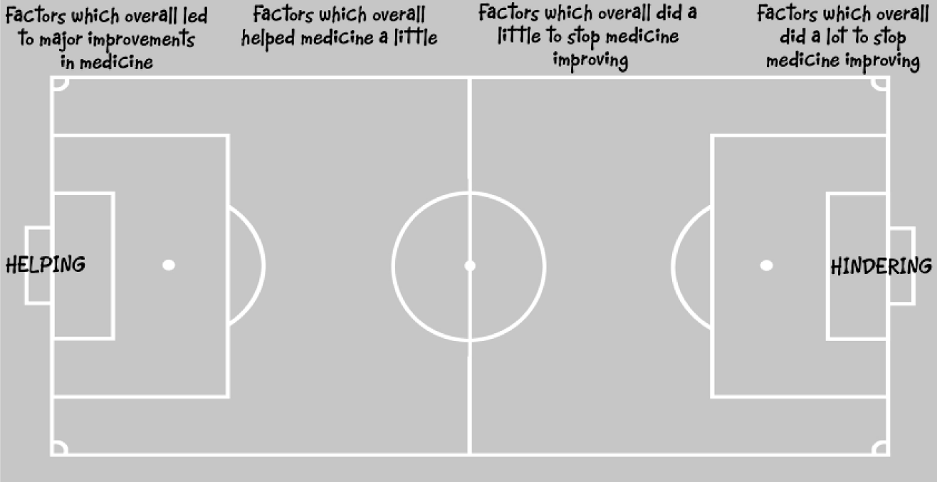
Final task: Relative significance
Allocate each individual in the table above a role in the team (or simply rank in importance if you don’t like football).
Then explain why some individual are more significant than others, using arrows to link.

Slide 47
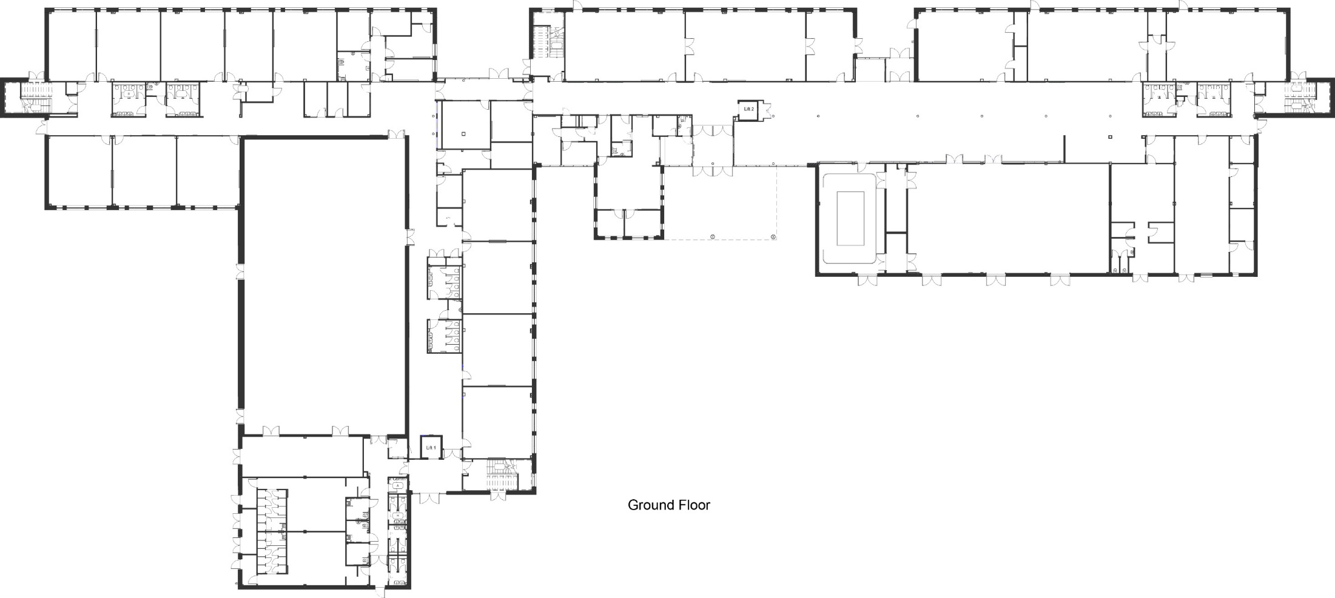

Back Entrance to Building B
Exit to Building B
Back Entrance to Building A
West
Stairs
Up
Only
North Stairs Down Only
East Stairs
Up Only
Exit Only
Front Entrance to Building A
South
Stairs
Down
Only
Front Entrance to Building B

Slide 48
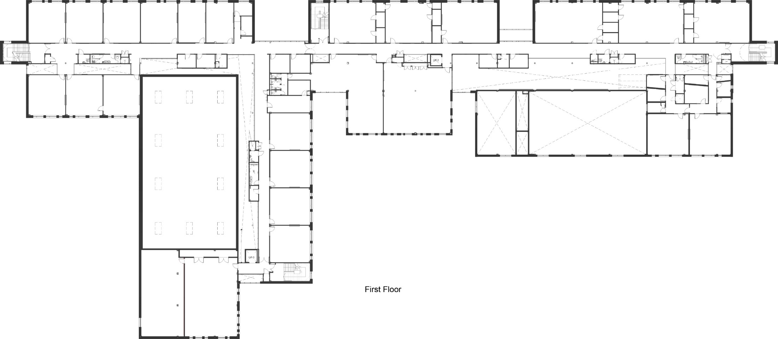
North Stairs Down Only
West
Stairs
Up
Only
East Stairs Up Only
South Stairs Down Only

Slide 49
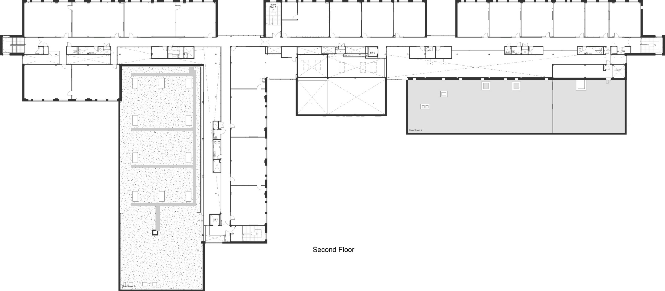
North Stairs Down Only
West
Stairs
Up
Only
East Stairs Up Only
South Stairs Down Only

