Slide 1
How did the lives of immigrants change during Roosevelt’s presidency?
Do Now:
Draw around both of your hands. On each finger, give a specific example of progress / limitations for women under Roosevelt’s presidency.
Don’t want to draw? That’s ok – list it instead!
PROGRESS
LIMITATIONS
On the one hand, …
On the other hand, …
Challenge: Were changes in women’s status a result of Roosevelt’s Presidency or a result of necessity brought about by the Second World War? Explain with examples.

Slide 2
Impacts for Immigrants
How did the lives of immigrants change during Roosevelt’s presidency?
Which of these groups might face the most significant change & why?
How would immigrants be impacted by the Great Depression? Why?
(Tip: think like ‘Brexit’)
How might Japanese, German and Italian immigrants be treated during WWII?
Is war more likely to bond or divide US society (specifically in regards to immigration)?
Notes:
Think, pair, share.

Slide 3
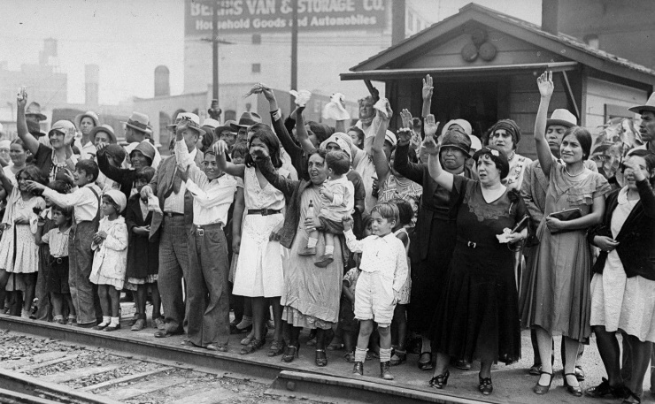
The Great Depression
How did the lives of immigrants change during Roosevelt’s presidency?
Large immigrant communities became influenced voting.
Immigrant communities typically voted democrat = Roosevelt.
BUT.
Immigrants were not well provided for under the New Deal (esp. Mexicans).
Shortage of jobs = resentment of immigrants. “American jobs for real Americans”.
Mexicans faced forced deportation. This started under Hoover (“American jobs for real Americans”) but continued under Roosevelt. About half were actually citizens.
Jews fleeing Germany also faced persecution – 60% disapproval rate. Assistant Secretary of State, Wilbur Car: “filthy, Un-American and often dangerous in their habits.”
Notes:
Use p64-65 of Access to History.

Slide 4
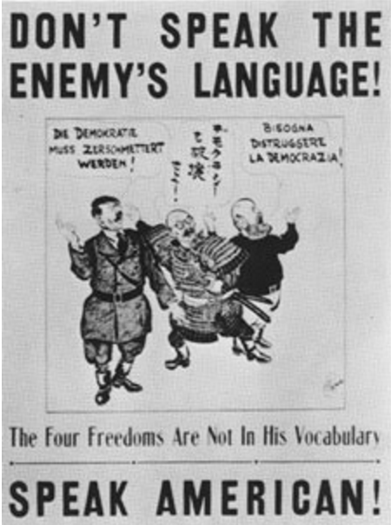
World War II
How did the lives of immigrants change during Roosevelt’s presidency?
There was a general cohesiveness, especially in the army, as many were forced to assimilate and learn English.
Italians and Germans experienced some discrimination and social isolation.
Japanese faced the worst discrimination.
For the Chinese, instances of immigration and the granting of citizenship increased as a result of anti-Japanese sentiment and subsequent sympathy for the Chinese.
Notes:
Use p64-65 of Access to History.

Slide 5
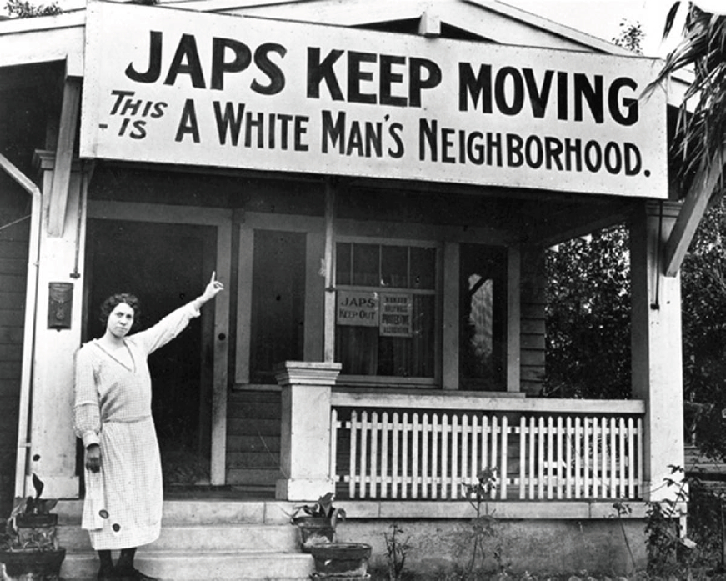
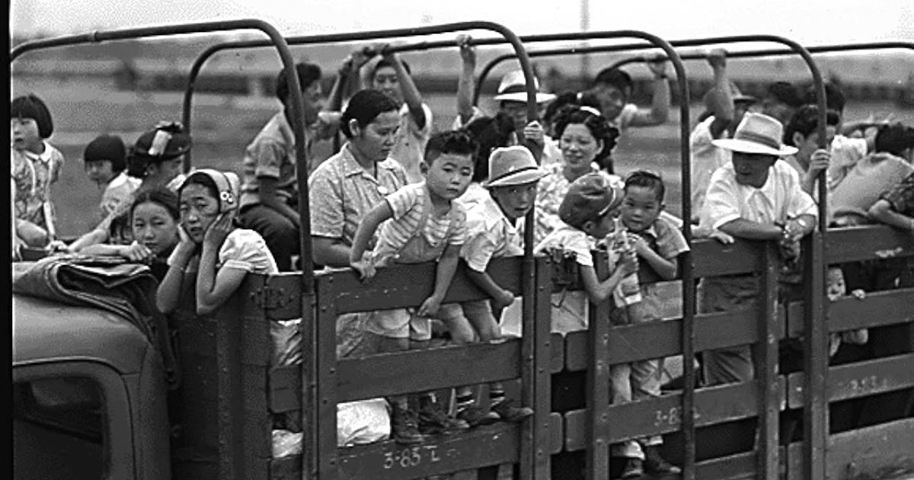
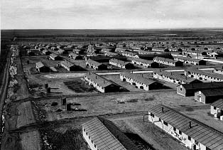
Japanese Internment Camps
How did the lives of immigrants change during Roosevelt’s presidency?
Japanese in particular faced discrimination as a result of the Japanese attacks on the US naval base in Pearl Harbour. Much of the discrimination was racial.
Internment camps were set up for over 100,000 Japanese who lived on the United States West-Coast who were deemed ‘enemy aliens’ and a security threat.
This was done under the Executive Order 9066 by President Roosevelt in February 1942.
Notes:
Use p64-65 of Access to History.

Slide 6
Immigration Under Roosevelt.
How did the lives of immigrants change during Roosevelt’s presidency?
Great Depression:
2x political impacts
2x social impacts
How did social life deteriorate for Mexicans and Jews, specifically? (Specific examples!)
World War II:
What were the negative impacts for:
Italians & Germans?
Mexicans?
Japanese (use two sheets here!)
How did this improve social life for Chinese immigrants?
How did this improve assimilation in the USA?
Challenge: Which had the greatest impact on immigrants: the Great Depression or World War II? Why? Make sure you consider both positive and negative impacts.
Notes:
Colour code notes to show +/- impacts.

Slide 7
‘On the whole, the Roosevelt administration facilitated greater cohesiveness between US society and its immigrant population’. How far do you agree?
How did the lives of immigrants change during Roosevelt’s presidency?
Fairly
Mostly
You cannot sit on the fence!
Somewhat
Little

Slide 8
To summarise…
How did the lives of immigrants change during Roosevelt’s presidency?
Give:
2x advantages for immigrants under Roosevelt.
2x disadvantages for immigrants under Roosevelt.
Who was better off under Roosevelt: women or immigrants? (Is there a caveat to this?)
Challenge: Was there more progress made in social lives or civil rights under Roosevelt’s presidency? How responsible is he for these progresses?

