Slide 1
‘New Deal programmes introduced during the presidency of F.D.R. failed Black Americans’.
How far do you agree with this statement? [20]
LOs:
1. To recall the grievances of black American in both the North and South
2. To support and explain the impact of the alphabet agencies and welfare programmes on black Americans, both positive and their limitations.
3. To weigh up the extent to which blacks benefited from the New Deal or whether it do more harm than good.

Slide 2

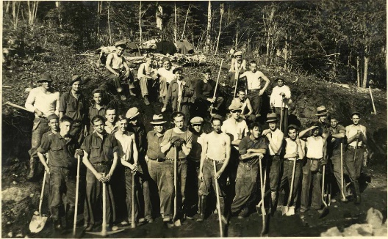
The First New Deal = Relief, Recovery and Reform
Roosevelt was granted emergency powers – much like a dictator – to pass emergency legislation to sort out the economy quickly. This first period in office was known as The ‘First Hundred Days’.
A whole host of ‘Alphabet Agencies’ – (termed this due to the fact they were known by their initials e.g. AAA, CCC) were set up to address the various issues America faced.
Roosevelt was a very personable and popular President which he took full advantage of with his use of ‘Fireside Chats’. Every letter which was sent to him by the American people he made sure was answered (he received, on average, 4,000 a day)
He had the media on his side as well due to his openness to questions and friendly nature – this meant that he could minimise criticism in the press to his plans.
At first many people backed Roosevelt’s plans with his New Deal. However, criticism started to grow as people accused Roosevelt of ‘socialist’ policies (which was a dirty word in America). They thought him too dictatorial.
In response to growing criticism, Roosevelt launched the Second New Deal in 1935.
The Civilian Conservation Corps, or, “Roosevelt's Tree Army

Slide 3
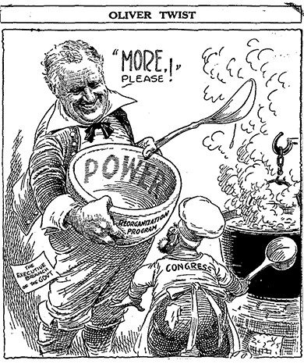
The Second New Deal = Social Security
Many historians have argued that the Second New Deal was more radical than the First New Deal. His First New Deal was largely aimed at dealing with the immediate problems of the Depression – relief, recovery and reform.
It is claimed that in his Second New Deal, Roosevelt was trying to radically alter American society, favouring the poorer classes at the expense of the rich. The emphasis was now on improving the lives of ordinary people, not on addressing the needs of business – “we have not weeded out the over-privileged, and we have not effectively lifted up the under-privileged.” – Roosevelt in his second Inaugural Address, January 1936.
In 1936 Roosevelt won a second election victory and he was at the height of his success. However, this did not mean that the New Deal was completely successful.

Slide 4
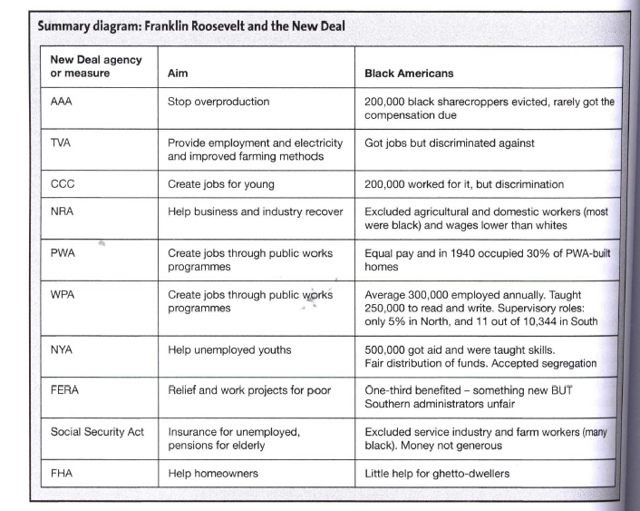
Look at the summary of the main government agencies and their impact on black Americans.
How did these agencies support black Americans?
Why would black Americans be disappointed overall by these agencies?

Slide 5
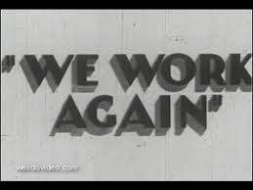
How valuable is ‘We work again’?
We Work Again is a US government film aimed specifically at the unemployed African American population in the wake of the Great Depression.
Accuracy?
Completeness?
Objectivity? (NOP)
https://www.youtube.com/watch?v=Gk0SpTOi9Aw

Slide 6
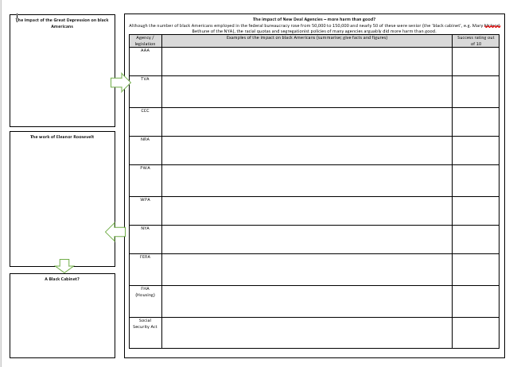
Task One:
Use page 70 to explain ‘The Impact of the Great Depression on black Americans’.
Task Two:
You will be allocated one/two government agency / legislation – summarise the impact on black Americans (positive and negative) using pages 73-84
Task Three:
Once you’ve completed yours, share to complete the table.
Task Four:
Use pages 90-93 to summarise the impact of Eleanor Roosevelt and the ‘black cabinet’
Challenge: Answer today’s question. Use page 85-86 to complete the two hands task on the back of your sheet

Slide 7

‘New Deal programmes introduced during the presidency of FDR failed Black Americans’. How far do you agree?
Identify 5 examples for each view
Use page 85-86, as it summarises a few key examples, but try to come up with your own too.

Slide 8
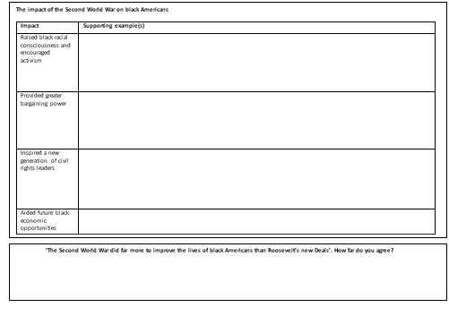
Task Five:
Use pages 59-60 to find examples of the effects of the Second World War on black Americans.
Challenge:
Compare the impact of WWII to the New Deal. Which had a more substantial effect?
‘The Second World War did far more to improve the lives of black Americans than Roosevelt’s new Deals’. How far do you agree?

Slide 9
HW: Due 27th November
Complete your improvement task – just add this in green pen.
Complete any outstanding notes from today’s lesson.
Read chapter 21 of Foner’s Give me Liberty! Summarise the following with a few examples each.
  What were the successes of the first 100 days and the First New Deal?
  What was ‘labour’s great upheaval’?
  What were the successes of the Second New Deal?
  How did Roosevelt change the meaning of American freedom?
  How did the New Deals affect women, black Americans and immigrants?
Challenge wider reading:
Read Sweet Land of Liberty by Robert Cook pp. 52-69. Complete the following three questions for each – give specific examples.
How were black Americans affected by the Great Depression?
How far did Roosevelt’s New Deal improve their civil rights and economic status? You might want to draw up a list of improvements vs limitations or simply highlight in two separate colours.
How did the NAACP campaign during the 1930s? What were their strategies and how far did they achieve their aims?

Slide 10
HW: Due 27th November
Complete your improvement task – just add this in green pen.
Complete any outstanding notes from today’s lesson.
Read chapter 21 of Foner’s Give me Liberty! Summarise the following with a few examples each.
  What were the successes of the first 100 days and the First New Deal?
  What was ‘labour’s great upheaval’?
  What were the successes of the Second New Deal?
  How did Roosevelt change the meaning of American freedom?
  How did the New Deals affect women, black Americans and immigrants?
Challenge wider reading:
Read Sweet Land of Liberty by Robert Cook pp. 52-69. Complete the following three questions for each – give specific examples.
How were black Americans affected by the Great Depression?
How far did Roosevelt’s New Deal improve their civil rights and economic status? You might want to draw up a list of improvements vs limitations or simply highlight in two separate colours.
How did the NAACP campaign during the 1930s? What were their strategies and how far did they achieve their aims?

