Slide 1
What was the impact of mass entertainment on American culture in the 1920s?
LOs:
1. To identify the causes of the growth of consumerism during the 1920s
2. To support and explain the impact of popular culture and news media the American way of life.
3. To weigh up the extent of change to American culture against the conservative attitudes that remained.

Slide 2
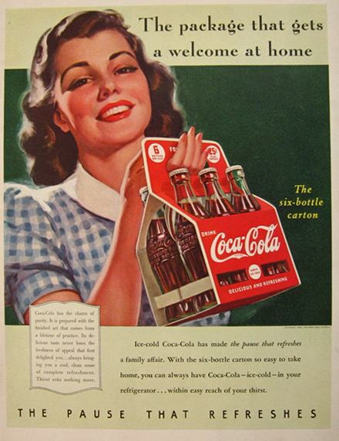
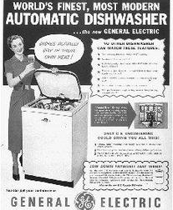
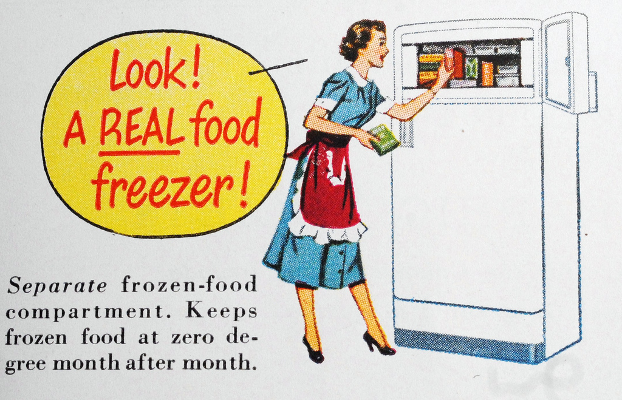
What were the causes of consumerism?
Notes:
https://www.youtube.com/watch?v=NvtsYZjL-wI

Slide 3
What were the causes of consumerism?
Industrial production and increased
Personal income = an aspiring middle-class
Women’s personal income
Investing in the booming stock market (Wall Street)
Increased wages
Mass production, reducing costs and therefore making items more affordable.
Credit system
New technologies – electricity, washing machines etc
Appliances offering convenience – vacuums, toasters, dishwasher's etc.
News media – radio and cinema
Advertising

Slide 4
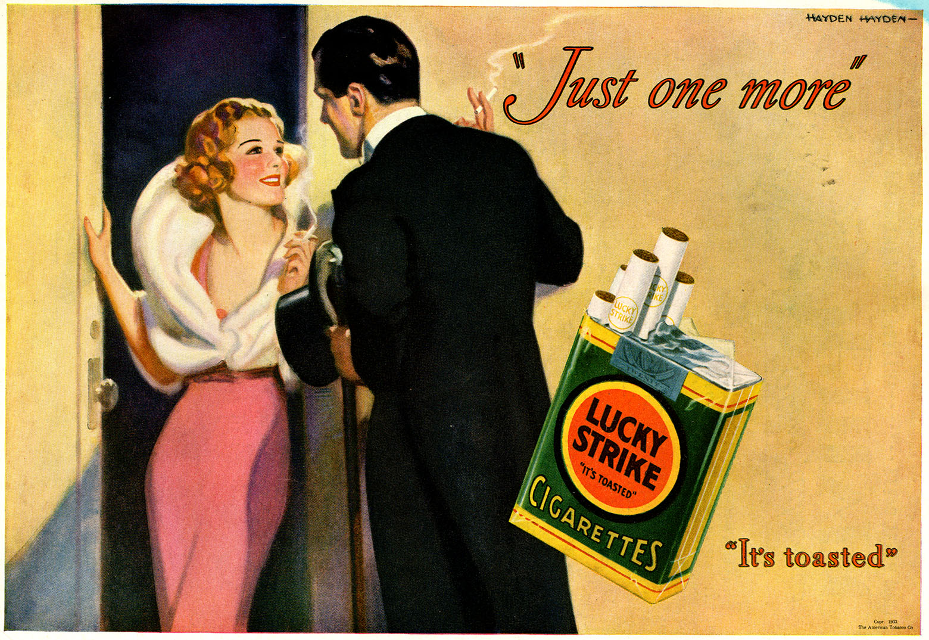
What is the purpose of this Lucky Strike advert?
Hayden Hayden, Liberty, October 21, 1933
How does it reflect changing attitudes towards women? Why might people criticise its morality?
Notes:
During the 1930s, Lucky Strike focused on romance and sexuality. Cigarette smoking was shown to be an activity for couples. Lucky Strike advertisements were featured on the back of weekly Liberty magazines, often alternating with Coca-Cola ads. These colorfully striking images were eye-catching as the back cover and drawn by well known illustrators of the time, including Neysa McMein, Hayden Sundblom, and Hayden Hayden.

Slide 5

HW Task: What was the impact of media on American society?
Use pages 30-35 to complete your table, weighing up social changes influenced by popular culture and media against limitations (e.g. were attitudes transformed? What concerns did conservatives have about the impact of media?)
Challenge: In the final column, suggest the extent of change experienced by American society. Try to use quantifying language to show extent.

Slide 6
Had American society been ‘transformed’?
Continuity
Change

Slide 7
Restrictions of Immigration – Closing the Golden Door
Civil Liberties
Rights asserted by the individual over democratic majority
Preserving freedom of speech
Self-Censorship – the Hays code.
Religious Fundamentalism
Reaction to ‘modernist’ adapting Christianity to secular culture
Billy Sunday
Prohibition
The Scopes Trial
The rise of the KKK to 3 million by mid 1920s.
The Red Scare
Sacco-Vanzetti Case
The Cable Act
Restrictions did not apply to Western hemisphere – need for cheap labour.
1921 – limited to 357,000 Europeans
1924 – limited to 150,000
What were the main features of the new society in 1920s?
The Jazz Age: A revolt against moral rules? Lax moral standards?
The decline of organised labour (Trade Unions)
Mass consumer culture
By 1929, the US was producing over 40% of the world’s manufactured goods and 85% of the world’s cars. Half of Americans owned a car.
Annual automobile production tripled from 1.5 to 4.8 million.
By 1929, weekly movie attendance doubled from 1922 to 80 million and there were nearly 5 million radios in US homes.
100 million records sold each year.
Changing image of Wall Street – 1.5m Americans owned stock by 1928.
Replaced politics? Voter turnout fell to less than 50% in 1924.
Limits – real wages rose by ¼ compared to corporate profits which more than doubled. 40% of the population lived in poverty. 60% of households did not own a radio in 1929 and 75% did not own a washing machine. Rural depression.
The liberated young single flapper
Birth control
Marketing
Labour-saving devices: washing machine, vacuum etc
Welfare Capitalism
TUs Lost 2m members

Slide 8
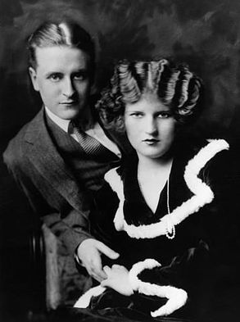
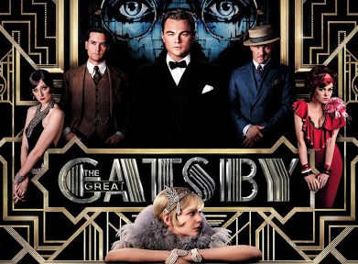
F. Scott. Fitzgerald
American writer F. Scott Fitzgerald (1896-1940) rose to prominence as a chronicler of the jazz age. Fitzgerald dropped out of Princeton University to join the U.S. Army.
The handsome, witty Fitzgerald seemed to be the ideal spokesman for the decade. With his stunning southern wife, Zelda, he headed for Paris and led a mythic career of drinking from hip flasks, dancing until dawn, and jumping into outdoor fountains to end the party.
The Fitzgeralds’ frenetic ascent to literary fame was soon tinged with tragedy. Scott became an alcoholic and Zelda, jealous of his fame (or in some versions, thwarted by it), collapsed into madness. They crept home in 1931 to an America in the grip of the Great Depression.
1925. The Great Gatsby.
As you watch Fitzgerald’s (and Baz Luhrmann’s) portrayal of the Roaring 20s:
List the elements of Jazz Age culture and consumerism that are captured by ‘The Great Gatsby’
If you’ve read it / seen the film, how are issues of morality are explored?
Notes:
https://www.youtube.com/watch?v=8ud6haTTfFY
https://www.youtube.com/watch?v=KG2XVUVQ2WY

