Slide 1
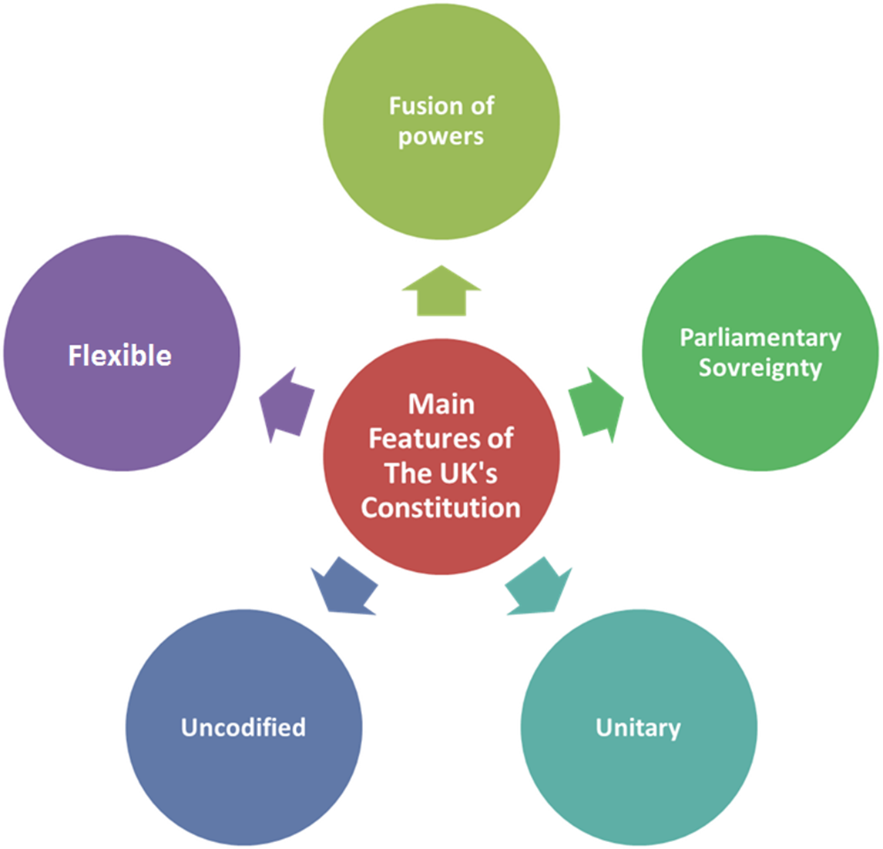
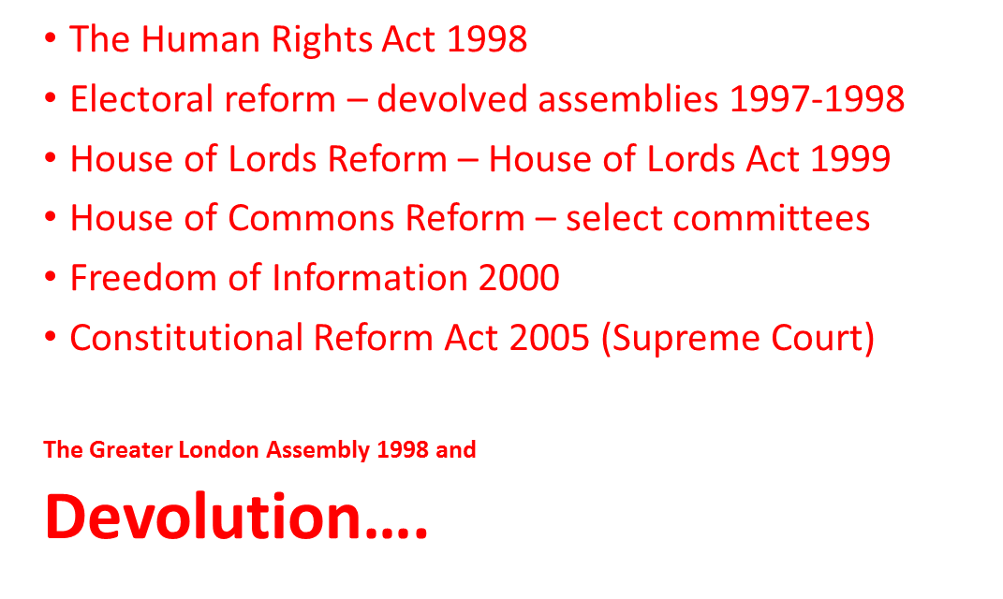
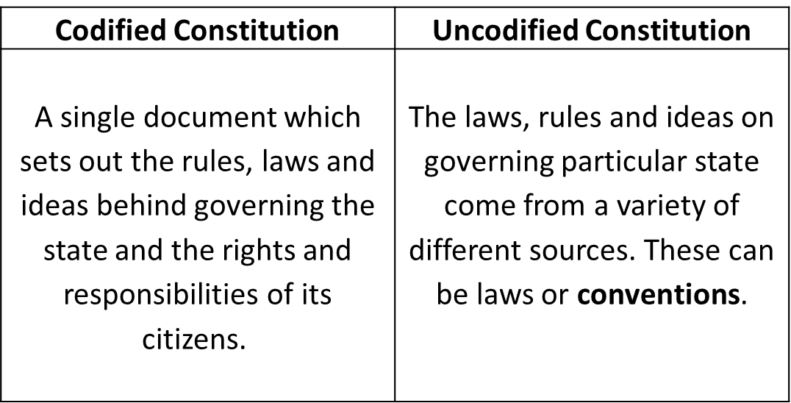
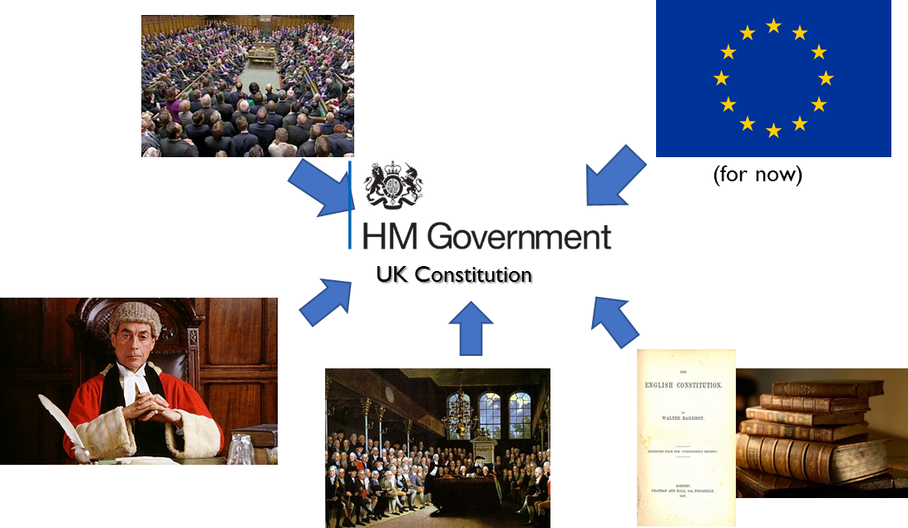
Constitution
Reforms 1997-2010
A set of laws and guidelines setting out how a political system works, and where power is located within the system. It defines the powers and functions of government and the rights of ordinary citizens in relation to the government.
Reforms 2010 onwards
Sources of the UK constitution
Further devolution – more powers to assemblies
English votes for English laws 2016
House of Lords Reform (didn’t happen) and boundary reform/fewer constituencies (not happened yet)
Electoral reform AV referendum (failed)
Scottish Independence referendum (16+ voting)
Fixed Term Parliaments
European Union Act
Reforms of the House of Commons – Select Committee Chairs elected and Backbench Business Committee
Elected mayors in major cities (only Bristol said yes in referendum)
Recall of MPs Act 2015
English votes for English laws 2016
Entrenchment is where constitutional rules are safeguarded against change by a future government or legislature.
Essentially the UK is an unentrenched constitution because it can be altered relatively easily (compared to the US) and there is no special, fixed legal procedure in place for amending it.
Statute Law
Parliamentary sovereignty – legal sovereignty lies with UK Parliament
Unitary constitution – legal sovereignty resides in 1 location
Power – powers of the different branches of gov are clearly defined and separated
Common Law
Conventions
Authoritative Works

Slide 2
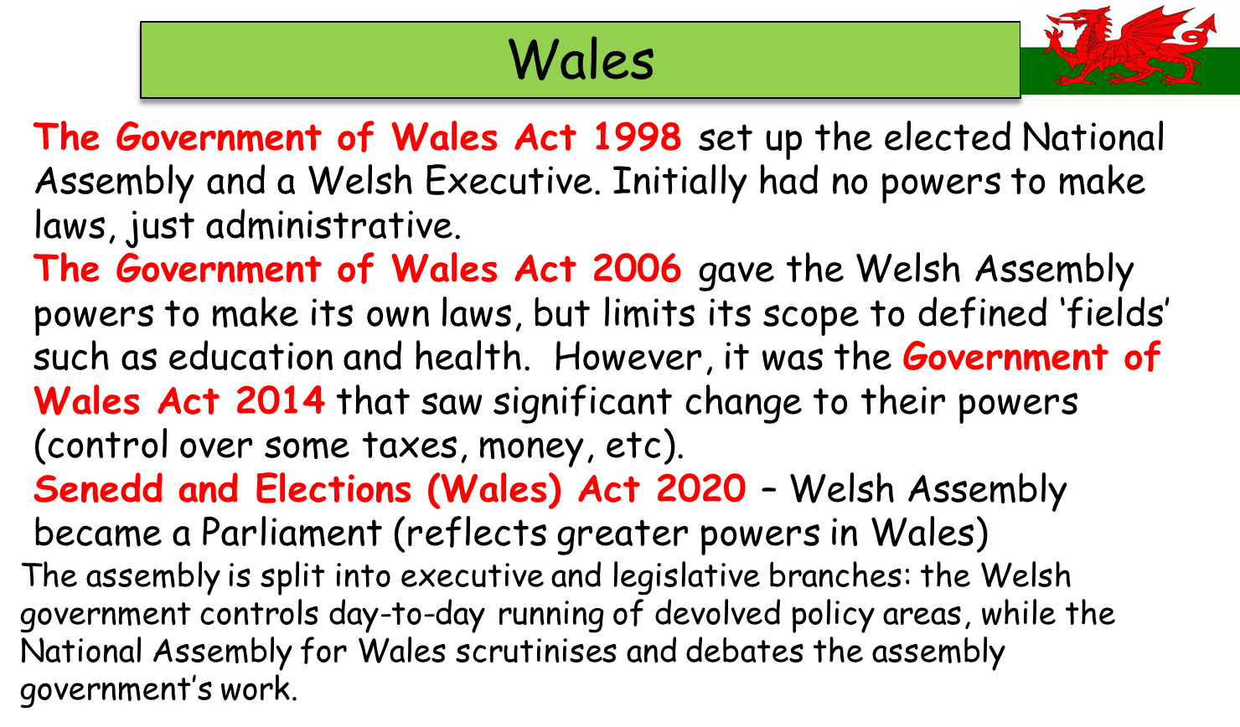
Devolution
Devolution: the transfer of power from the central government to subordinate regional institutions, but without a transfer of sovereignty (i.e. central government could, in theory, abolish the regional institutions, and take back their powers.

Slide 3
Parliament
The House of Commons
Publicly elected chamber of Parliament. Members of the Commons debate the big political issues of the day and proposals for new laws. 650 MP’s
Parliament's role
Parliament is an essential part of UK politics. Its main roles are examining and challenging the work of the government, debating and passing all laws and enabling the Government to raise taxes
Making laws
Law making is one of Parliament’s essential roles. Find out how new laws are made and learn how a Bill passes through Parliament and becomes an Act
Committees
Much of the work of the House of Commons takes place in committees, made up of around 10 to 50 MPs. These committees examine issues in detail, from government policy and proposed new laws, to wider topics like the economy
The Lords has three main roles:
Making laws
Members spend more than half their time in the House considering bills (draft laws). All bills have to be considered by both Houses of Parliament before they can become law. During several stages, members examine each bill, line-by-line, before it becomes an Act of Parliament (actual law). Many of these bills affect our everyday lives, covering areas such as welfare, health and education.
In-depth consideration of public policy
Members use their extensive individual experience to investigate public policy. Much of this work is done in select committees - small groups appointed to consider specific policy areas. Many select committee meetings involve questioning expert witnesses working in the field which is the subject of the inquiry. These meetings are open to the public.
Holding government to account
Members scrutinise the work of the government during question time and debates in the chamber, where government ministers must respond. In the 2016-17 session, members held the government to account with 7,380 oral and written questions and 154 debates on topical issues and public policy. The public is welcome to visit and sit in the galleries overlooking the chamber during business.
The business of Parliament takes place in two Houses: the House of Commons and the House of Lords. Their work is similar: making laws (legislation), checking the work of the government (scrutiny), and debating current issues.
The House of Commons is also responsible for granting money to the government through approving Bills that raise taxes. Generally, the decisions made in one House have to be approved by the other.
In this way the two-chamber system acts as a check and balance for both Houses.
Functions of Parliament
Approve legislation
Parliament has to approve legislation, taxation and public spending.
Provide political legitimacy
In a general sense passing the Government’s proposals give legitimacy to them in the eyes of the
Hold the Government to account
Parliament is meant to bring the Government to account and question it if it looks as if it has done something wrong.
Broader scrutiny
Scrutiny is a process by which Parliament examines what the Government is doing
A place for debate
Parliament should be the forum for debate about major decisions.
A place to raise people’s issues
Parliament is a place where the concerns of different groups in society can be raised.

Slide 4
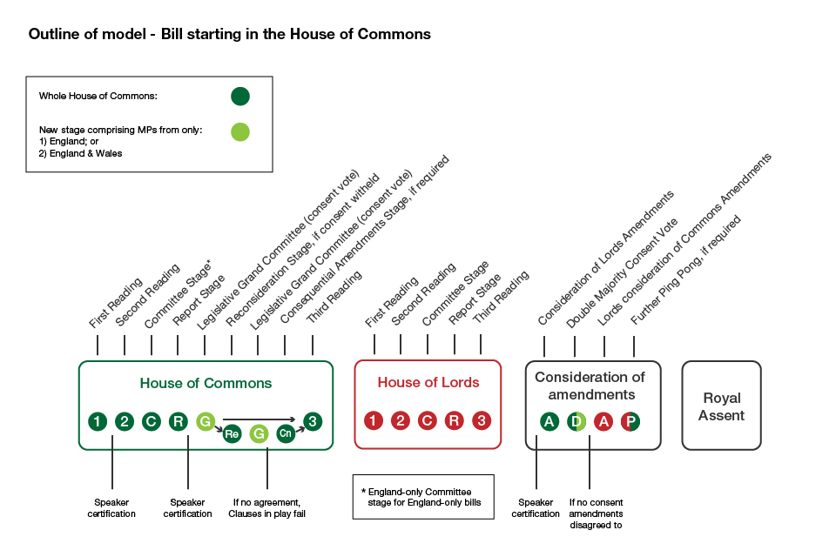
Legislative process
Role and significance of backbenchers, select committees and opposition
The opposition are there to hold the government to account and to present an alternative option to the electorate (in the case of general elections).
Labour – Kier Starmer
As leader of the opposition, he has to strike a balance between criticising ministers (holding the government to account) as well as coming across as statesmanlike in the position as a possible future PM.
Opposition parties are allocated 20 days a year to propose subjects for debate.
The Prime Minister answers questions from MPs in the Commons every sitting Wednesday from 12pm to 12.30pm.
The Salisbury Convention is a constitutional convention under which the House of Lords will not oppose the second or third reading of any government legislation promised in its election manifesto.

Slide 5
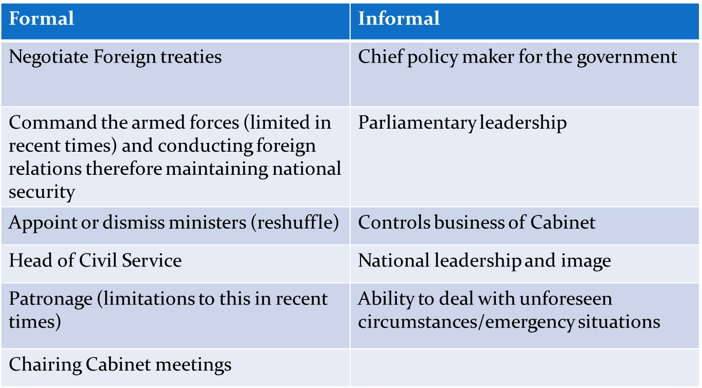
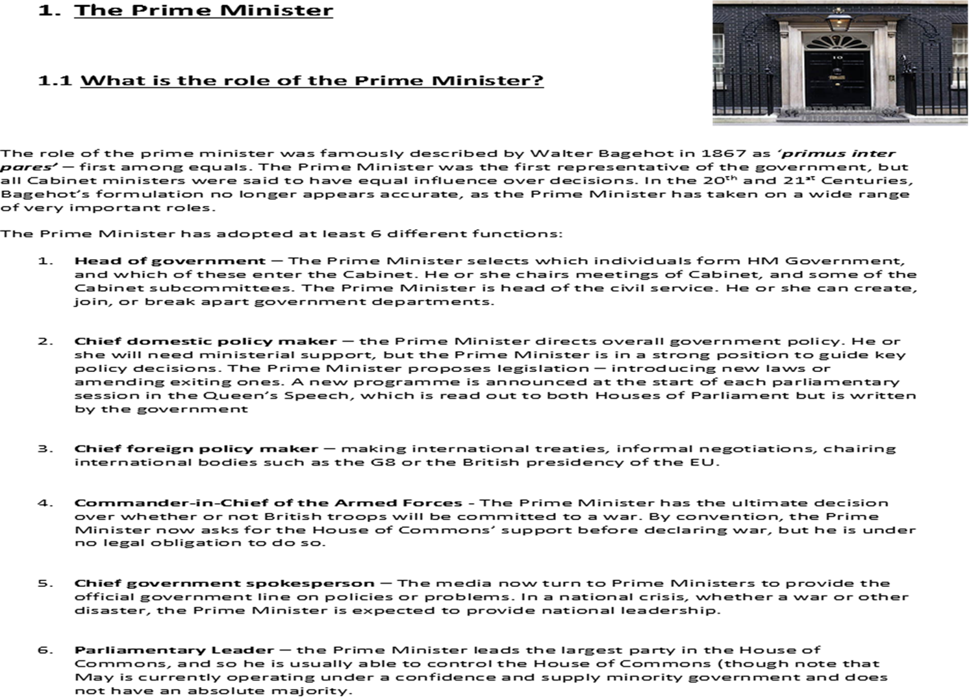
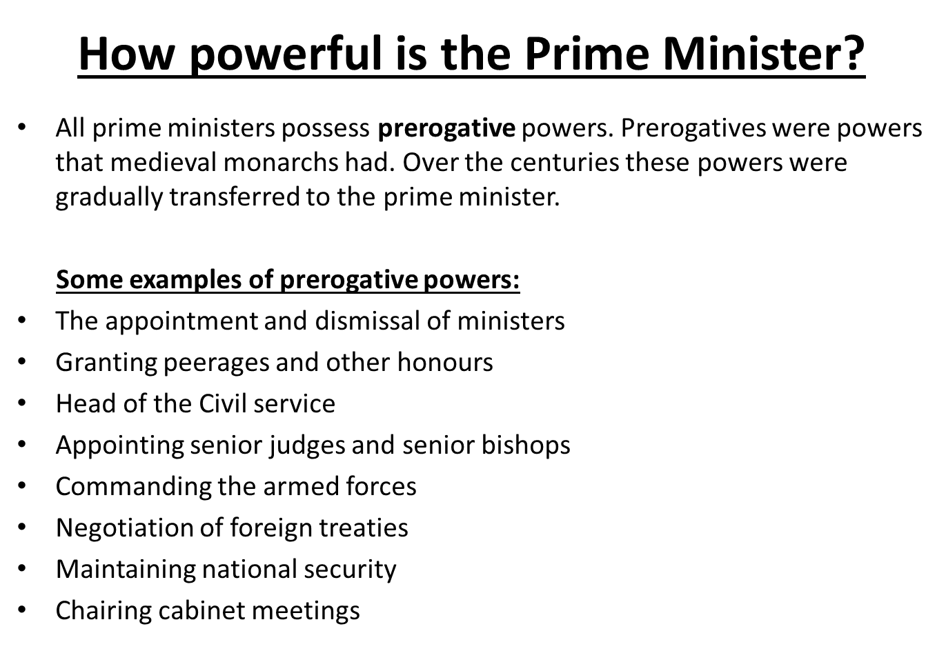
Prime minister
Powers of the PM

Slide 6
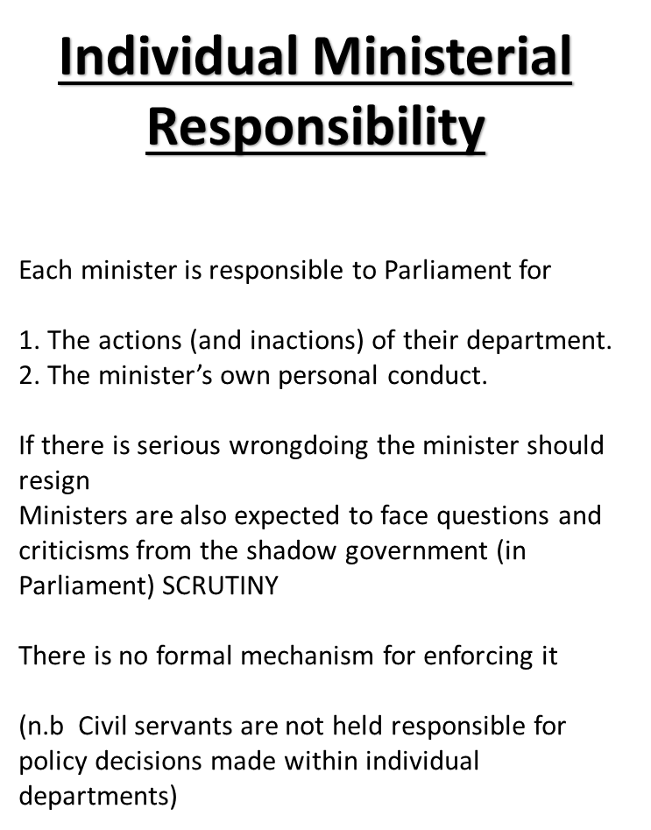
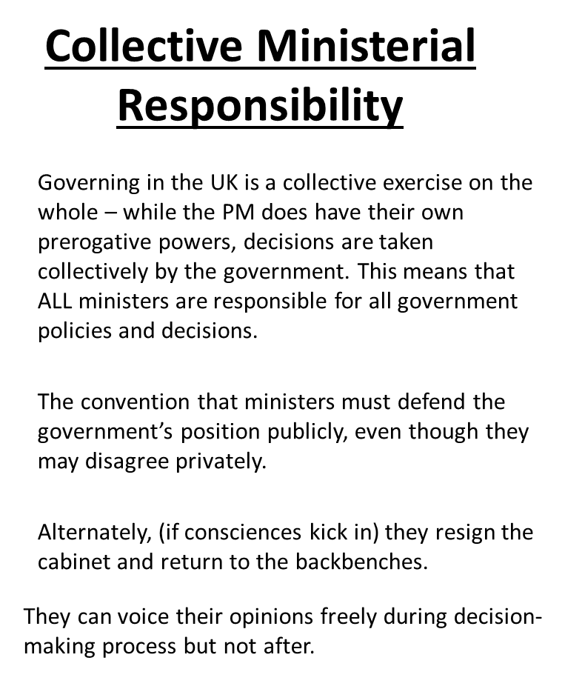
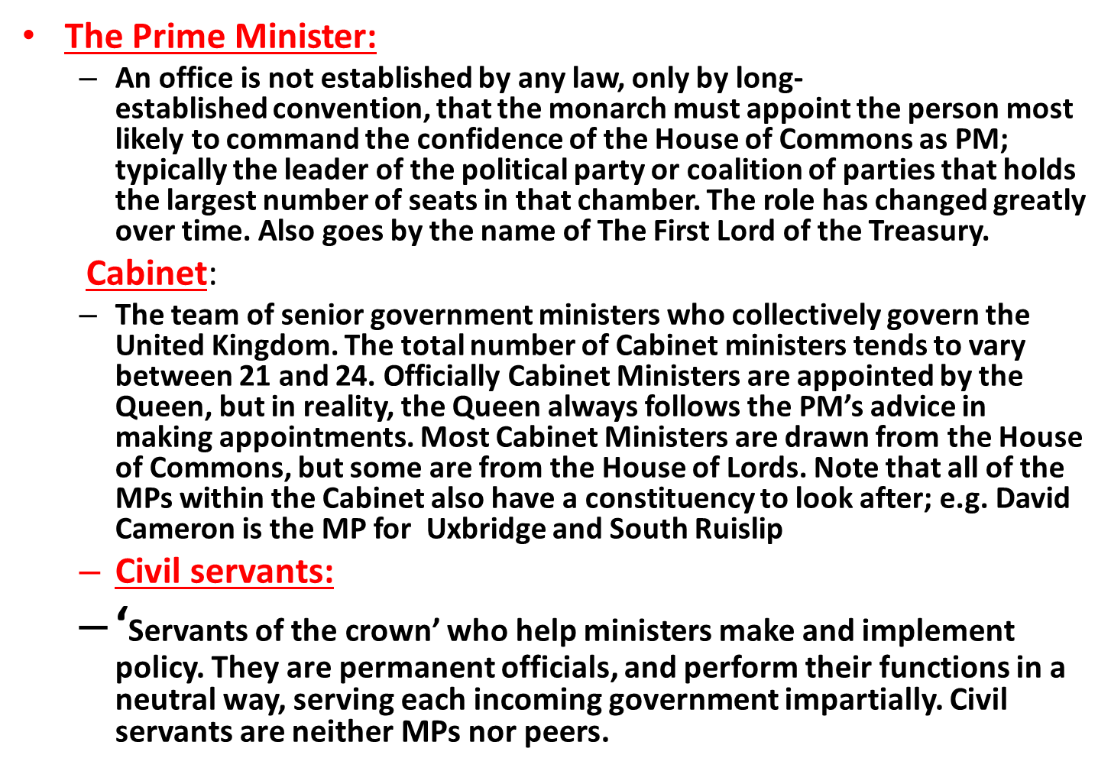
Role of the cabinet
Dispute resolution
Forum for debate
Symbol of collective government
Policy approval
Policy coordination
Party management

Slide 7
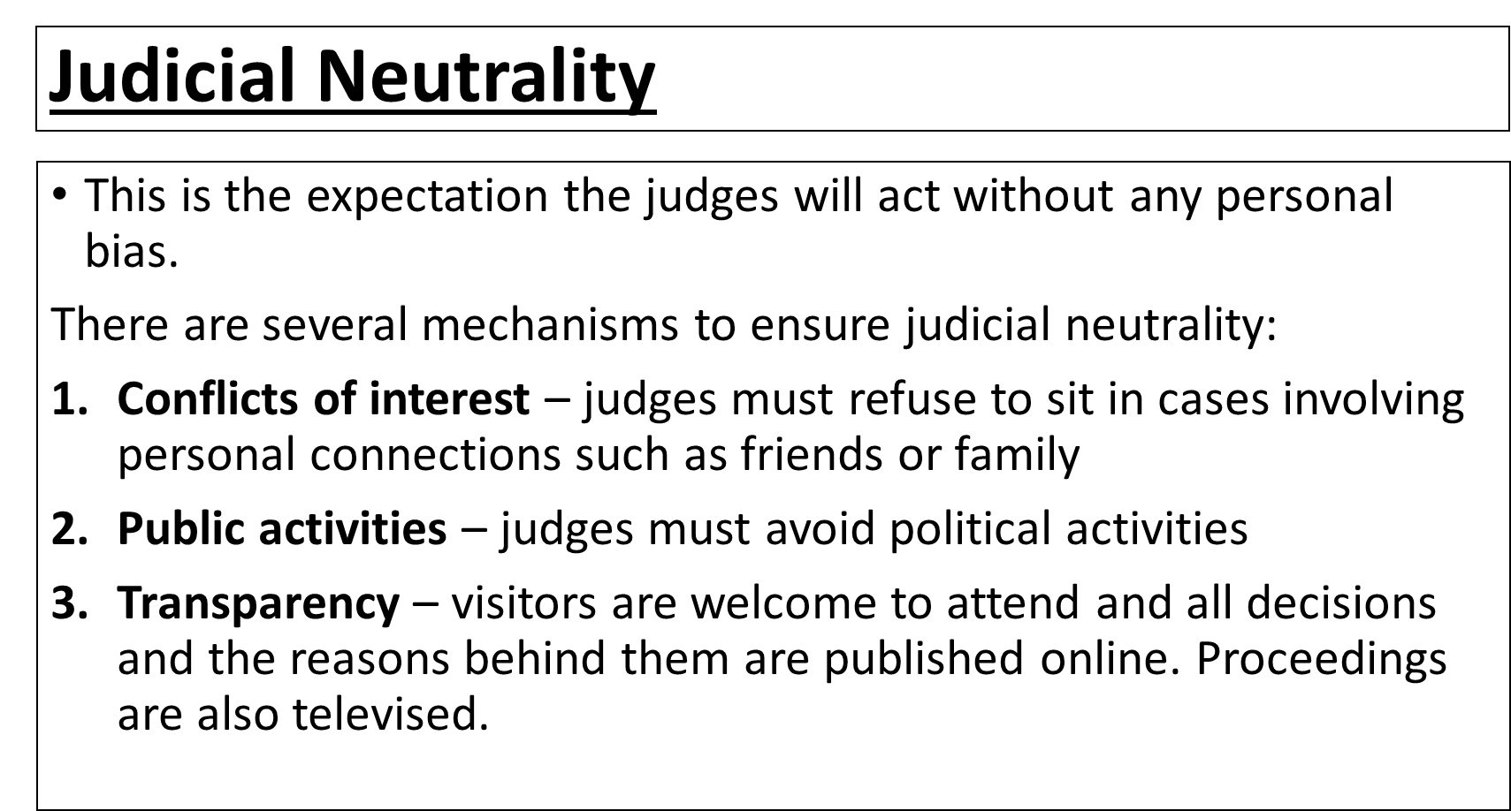
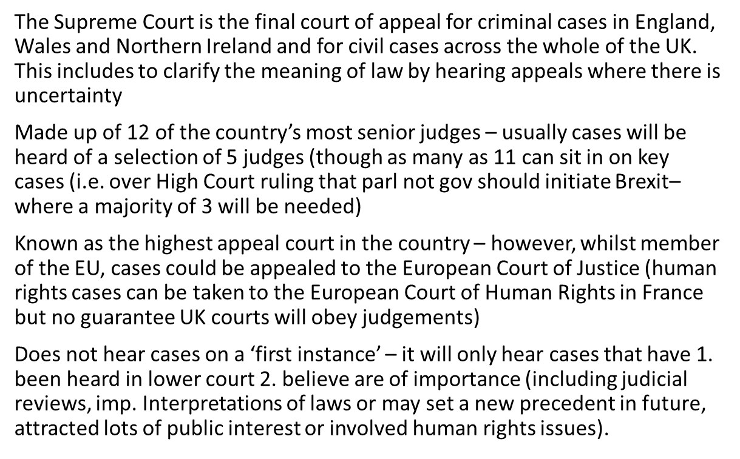
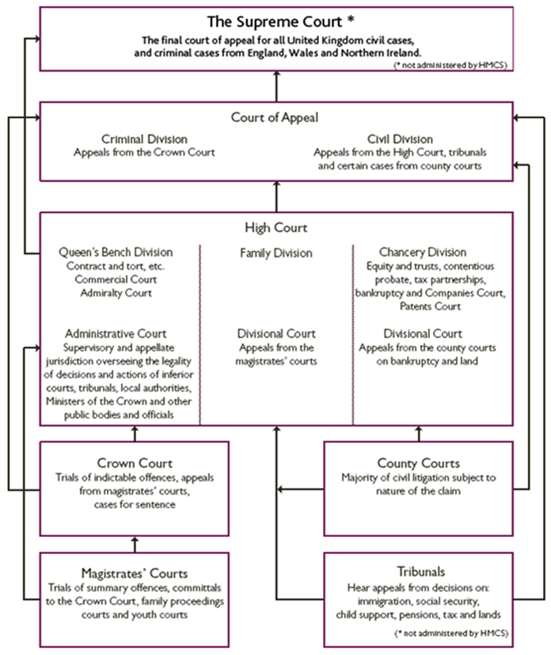
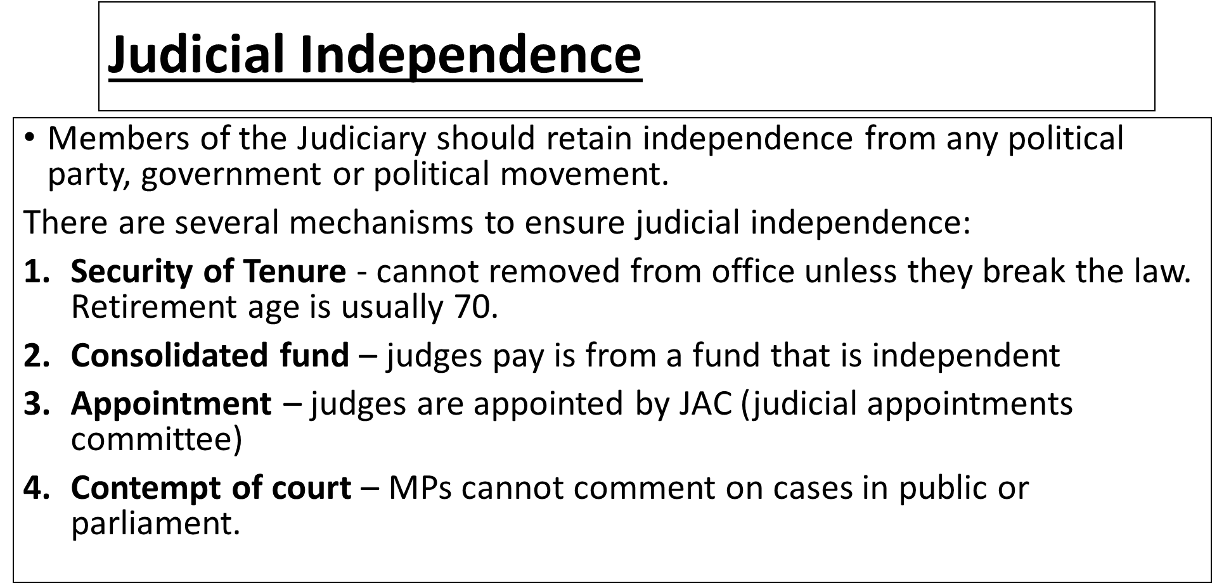
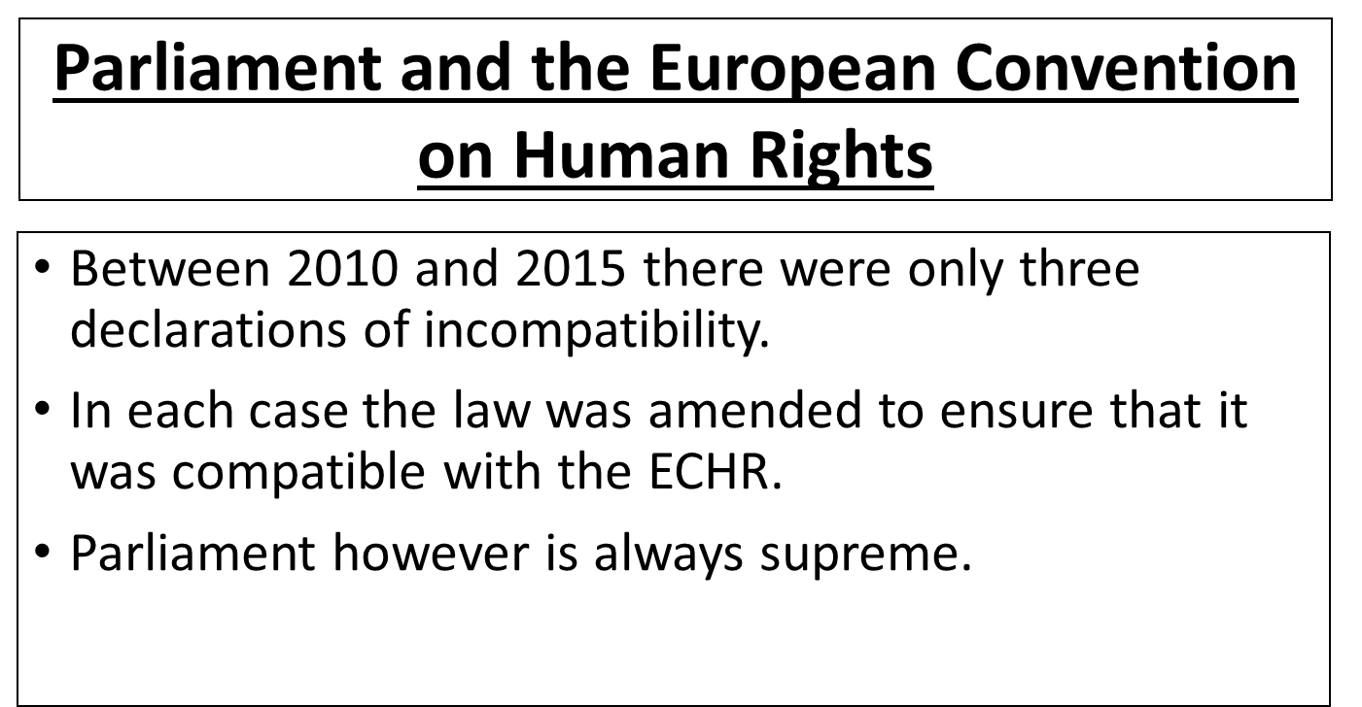
The supreme court
The Judiciary
Ultra vires
A legal principle that literally means ‘exceeding one’s power’. When an action is ruled ultra vires by a court it means the individuals or body that takes the action was exceeding its legal power.

Slide 8
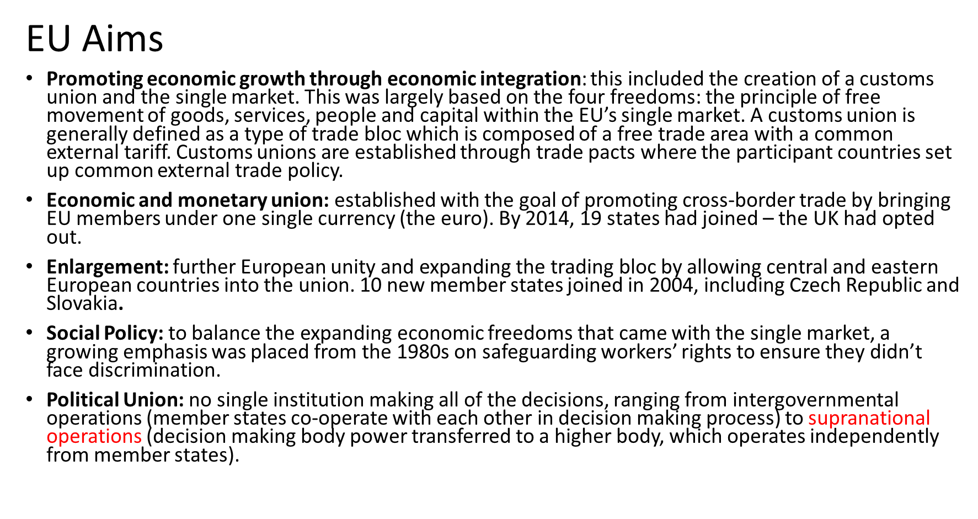
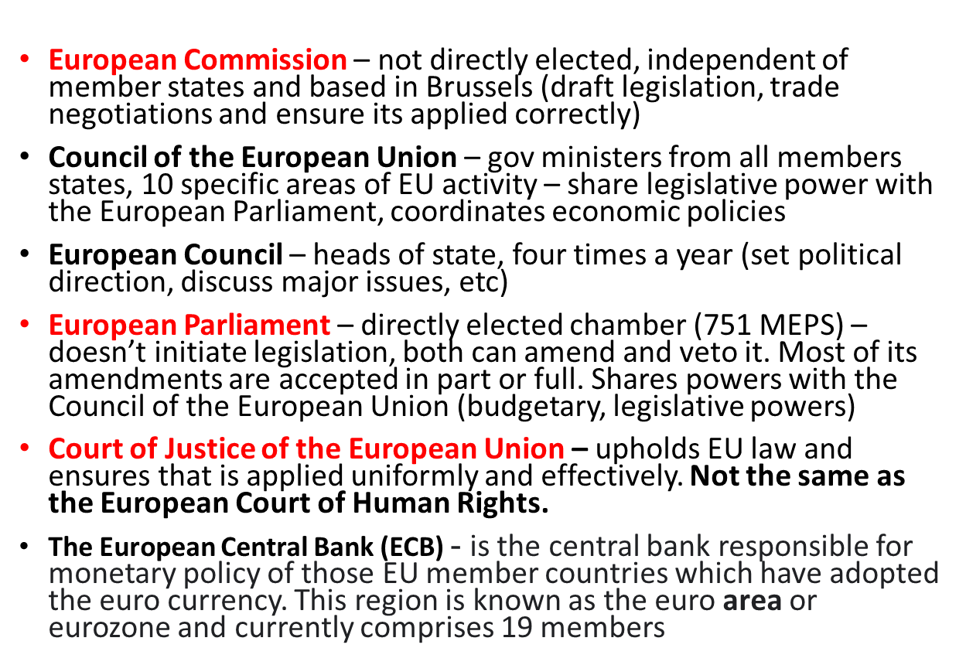
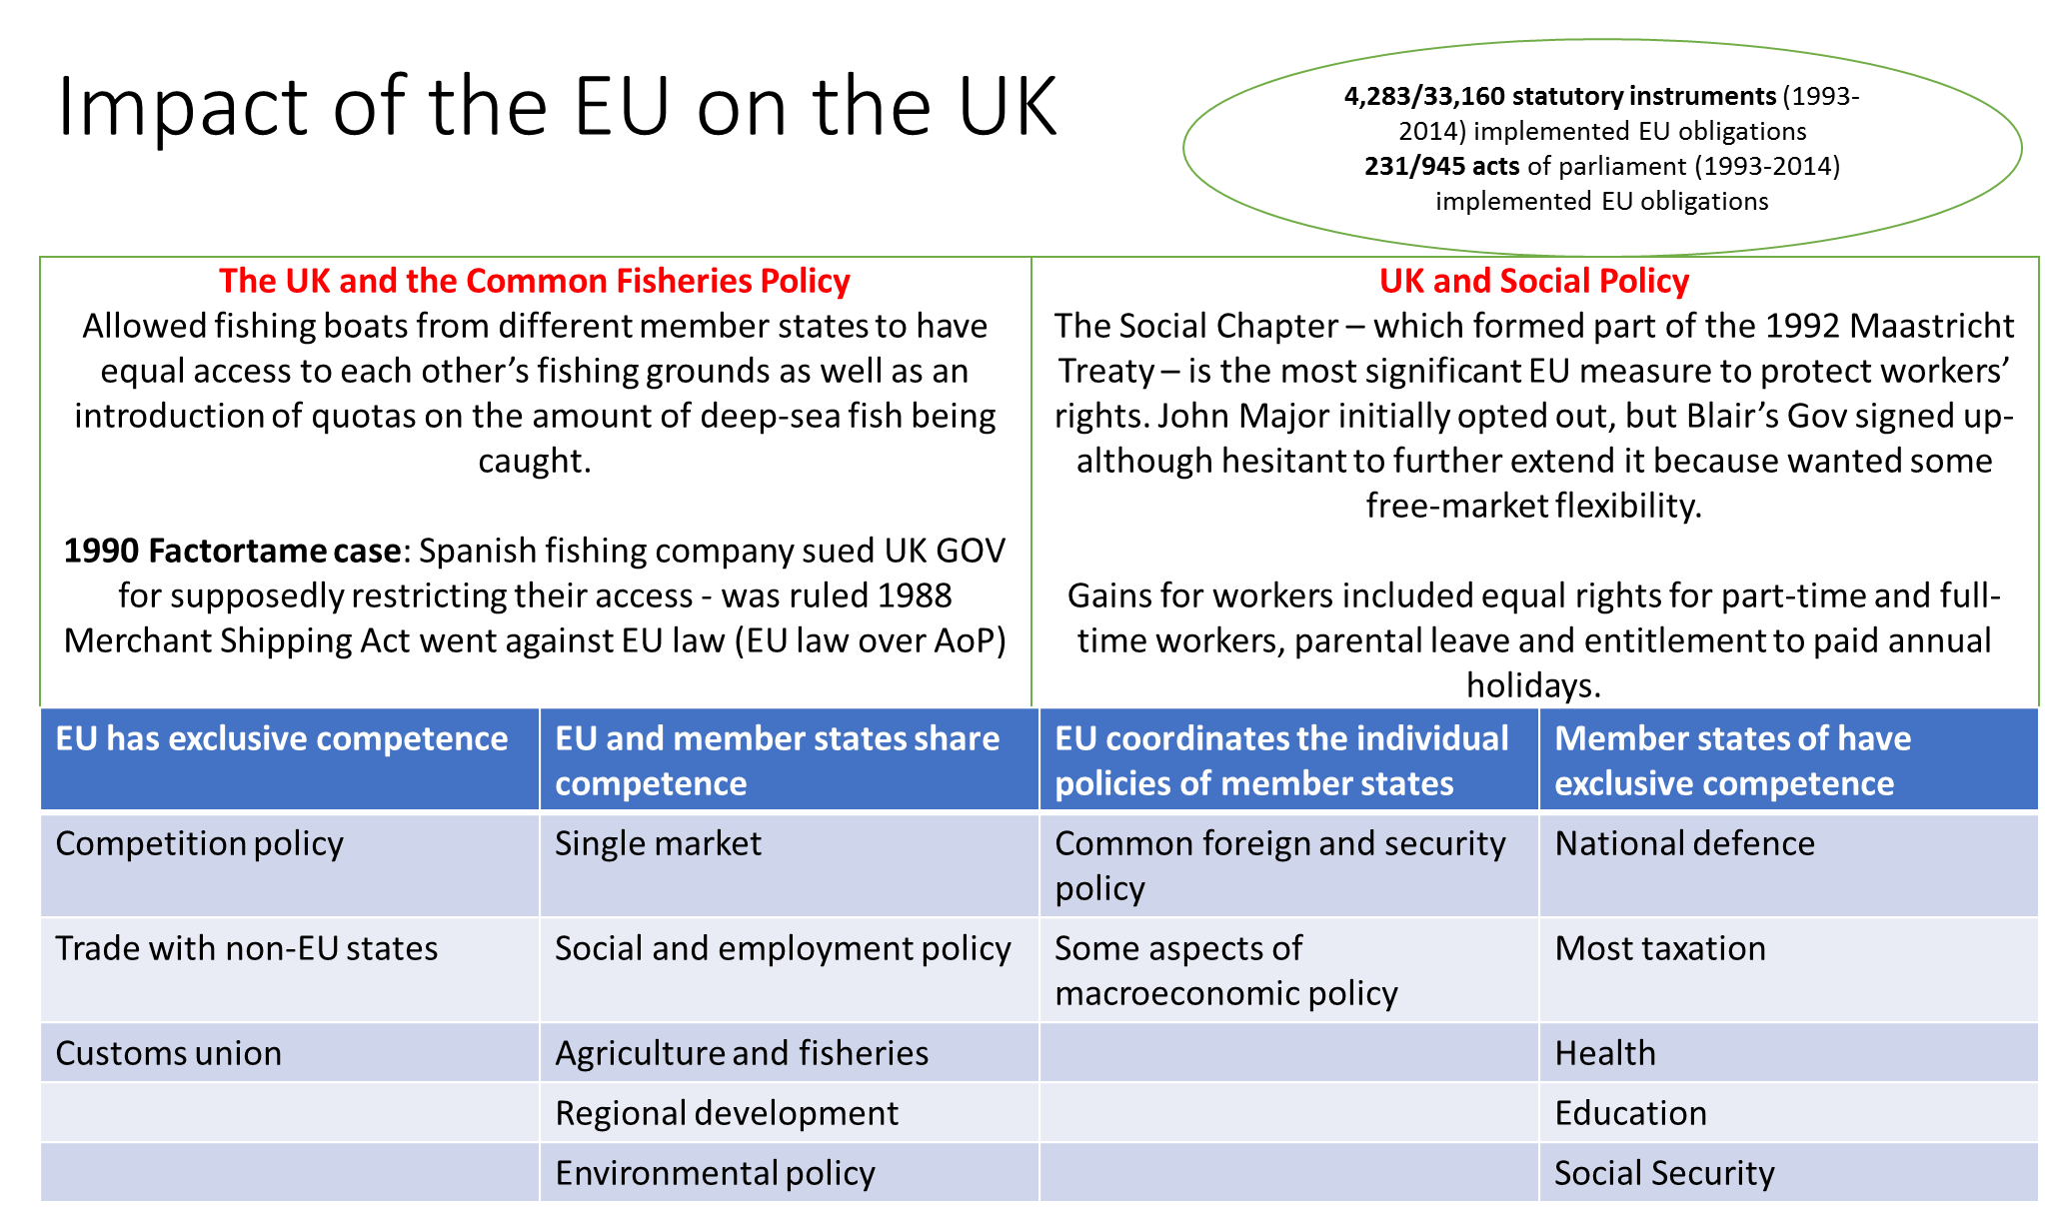
EU structure
Sovereignty is returned to the UK – ALL HAIL BREXIT!

